Slide 1
Lecture 4A: Visualizations & considerations for binarizing serological data
May 22, 2025
Seroanalytics Training Blantyre, Malawi
Notes:
4

Slide 2
Lecture outline
Data visualization
Why binarize serological data?
Calculating seroprevalence from a cutoff
Selecting controls

Slide 3
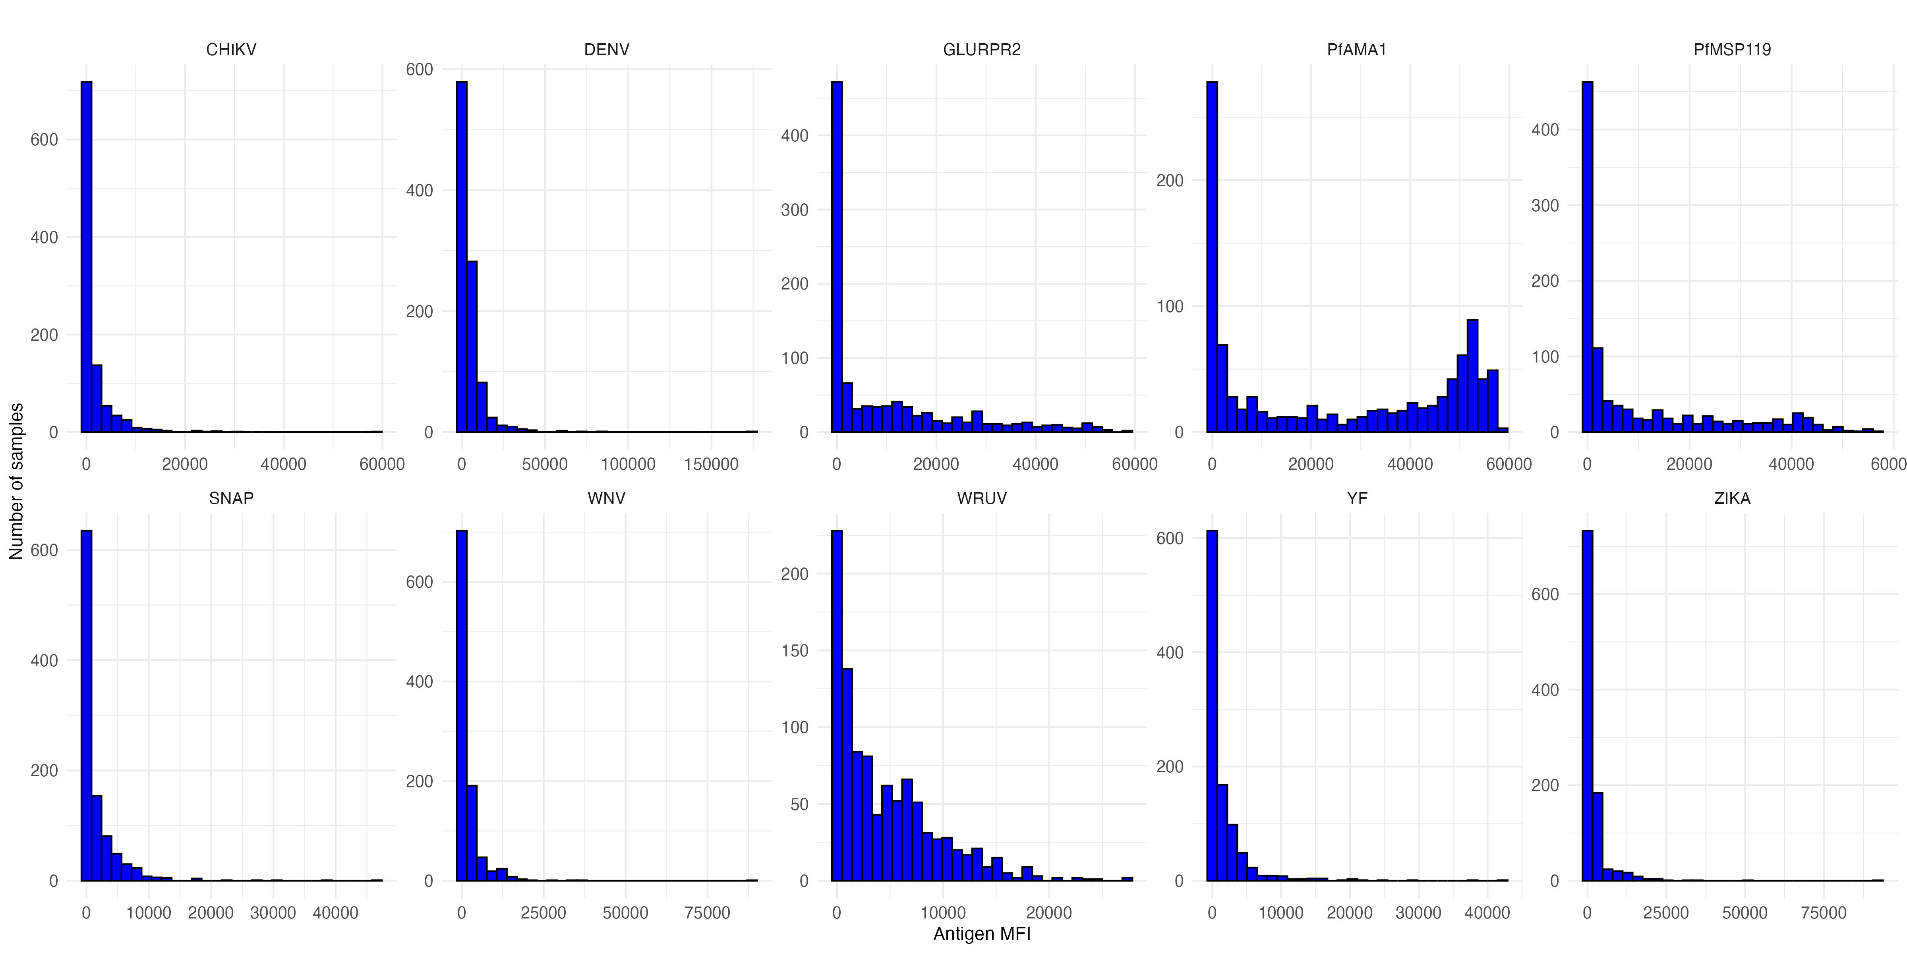
Visualizing serological data with histograms
How would you compare the different distributions of data (untransformed)?

Slide 4
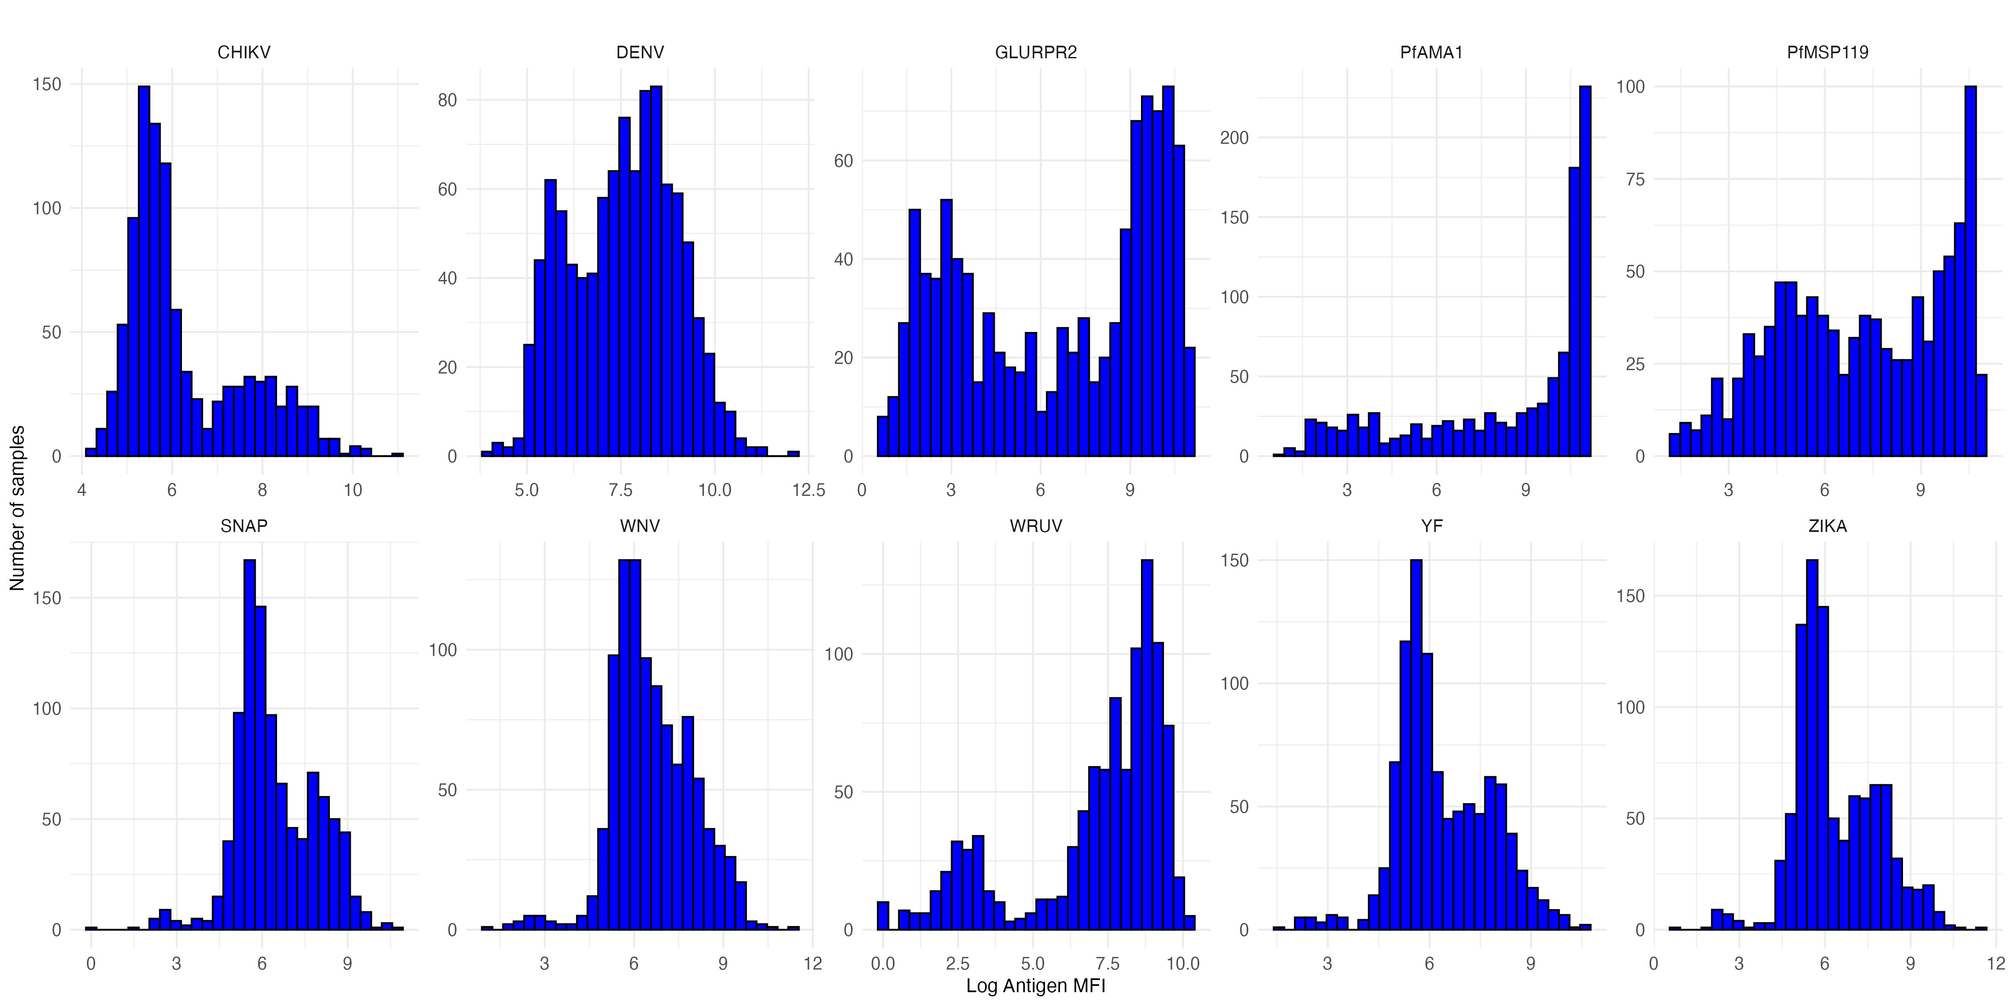
Visualizing serological data with histograms
How would you compare the different distributions of data (log transformation)?

Slide 5
Visualizing serological data with histograms
How would you compare the different distributions of data?
Skewed vs. non-skewed distributions
Unimodal vs. bimodal vs. multimodal
Narrow or wide distribution
Are there outliers?

Slide 6
Visualizing serological data with histograms
What underlying differences might cause the different distributions of data?

Slide 7
Visualizing serological data with histograms
What underlying differences might cause the different distributions of data?
Mix of exposed and unexposed in population
Mix of vaccinated / unvaccinated
Waning antibody responses

Slide 8
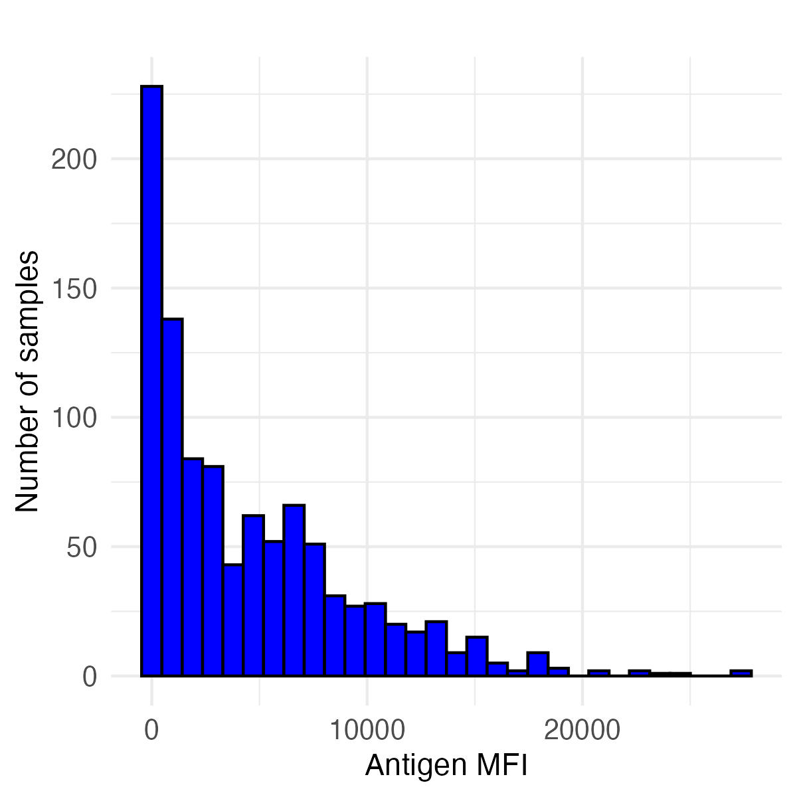
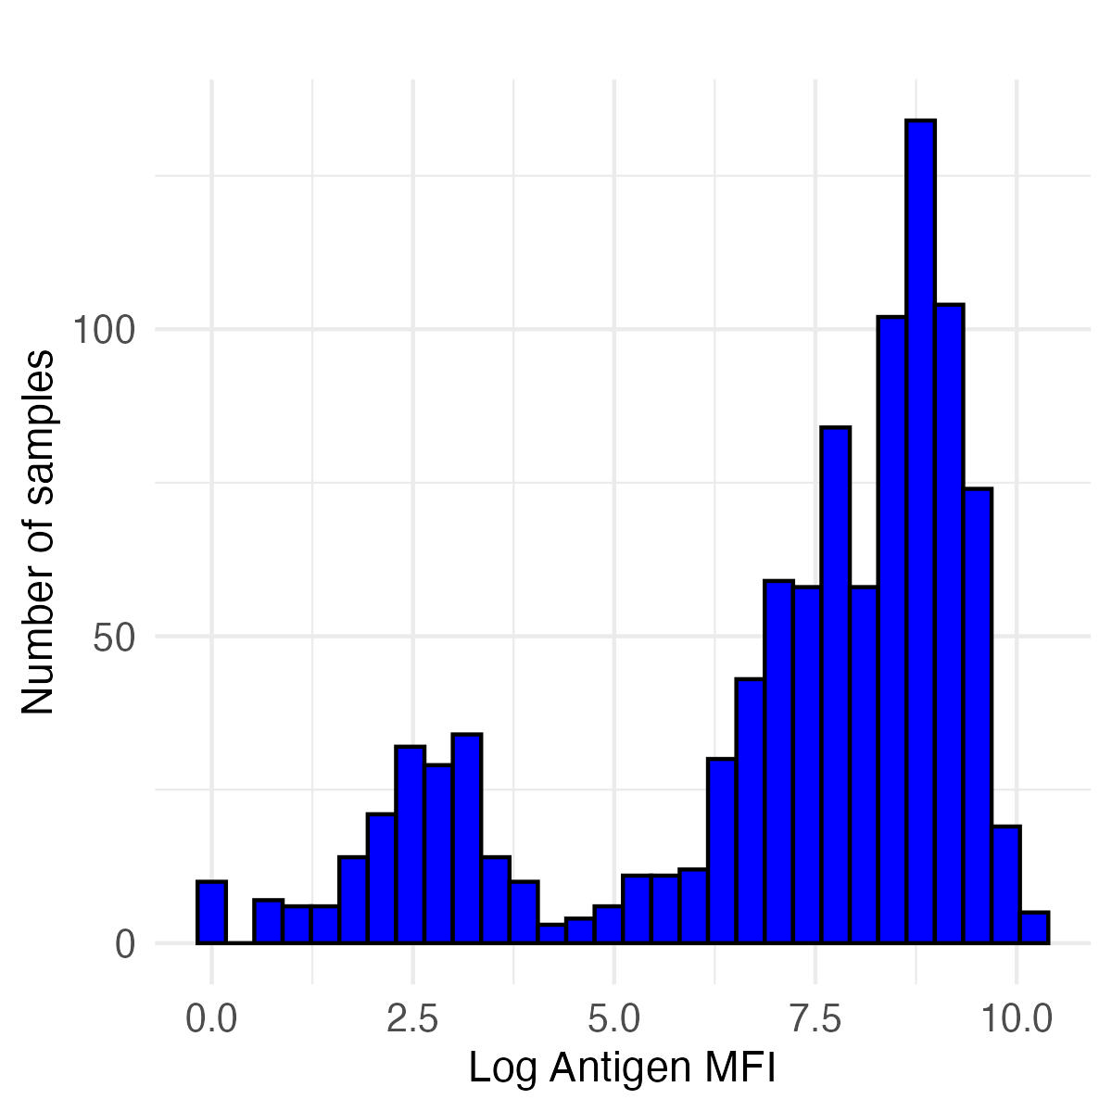
Histograms of rubella (wruv) antibody responses
Untransformed MFI Values Log transformed MFI values
How to get information from histograms like these?
How to compare the results of different histograms?
What inferences can we make about pathogen exposure based on a histogram?
A method of making inferences from distributions is binarizing data
Setting a cutoff, and everything above that cutoff is positive

Slide 9
Histograms of rubella (wruv) antibody responses
Untransformed MFI Values Log transformed MFI values
Rubella has a correlate of protection
Individuals with antibody responses above a certain cutoff are expected to be protected from rubella infection
By applying a cutoff equivalent to the correlate of protection, we can calculate seroprevalence (here, also equals the immune proportion)

Slide 10
Histograms of rubella (wruv) antibody responses
Untransformed MFI Values Log transformed MFI values
Rubella correlate of protection is 9.36 IU/ml (International Units per milliliter)
However, the Luminex assay gives us antibody units in MFI (median fluorescence intensity)
We can convert between MFI and IU/ml using a standard curve: we convert all MFI values to IU/ml, and apply the 9.36 IU/ml cutoff

Slide 11

Getting MFI values from standard curves
The standard curve is created using known concentrations of antibody standards (e.g., the WHO International Standard for rubella, below), ideally measured on the same plate(s) as the unknown samples.
https://nibsc.org/documents/ifu/RUBI-1-94.pdf

Slide 12
Converting MFI values to standardized units (IU/ml) from standard curves
(Recall we used standard curves to estimate relative antibody units.)
First, we fit a model to our standard curve data to establish the relationship between MFI values and known IU/mL concentrations.
Then, we can use this model to convert MFI values for the samples of interest to IU/ml.
Lastly, we apply the 9.36 IU/ml correlate of protection cutoff to the samples of interest to determine a binary serostatus for each sample.
Notes:
Please note that the cutoff value of rubella 9.36IU/mL comes from the following analysis: https://pmc.ncbi.nlm.nih.gov/articles/PMC8316076/ wherein “the ROC analysis for the RuV WVA MBA was performed on 152 paired serum samples (Table 1), using the quantitative ELISA as a classifier and resulted in an AUC of 1, a sensitivity of 99%, and a specificity of 100%, with a cutoff of 9.36 IU/ml (Fig. 8E)."

Slide 13
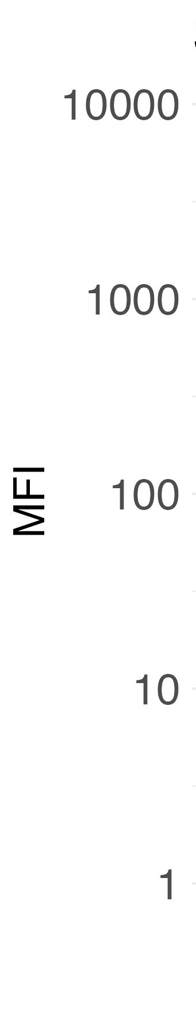
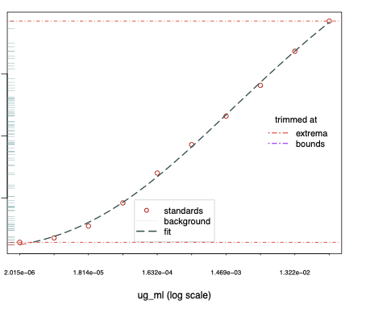
Converting MFI values to standardized units (IU/ml) from standard curves
For rubella (WRUV), we can apply the cutoff (based on correlate of protection) of 9.36 IU/ml to determine individual serostatus
cutoff (9.36 IU/mL)
observed sample data
1 10 100
WRUV concentration (IU/mL)

Slide 14
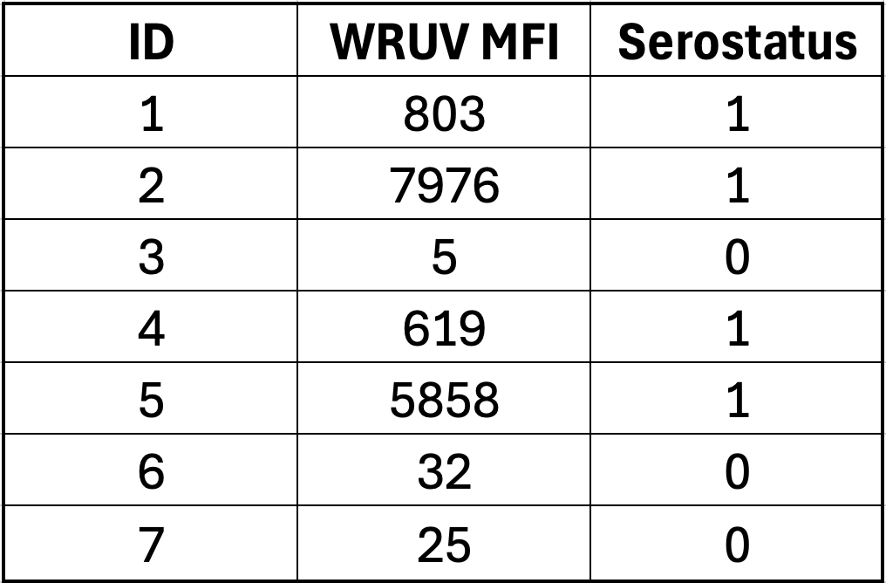
Determining serostatus from a cutoff
For each sample in the dataset, we identify each as seropositive (1) or seronegative (0)

Slide 15
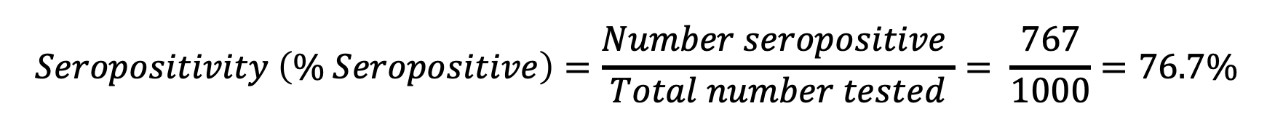
Calculating seropositivity or seroprevalence
For WRUV with a cutoff of 9.36 IU/ml, we have:
767 seropositive samples
233 seronegative samples
$$Seropositivity \left(\% Seropositive\right)=\frac{Number seropositive }{Total number tested}= \frac{767}{1000}=76.7\%$$

Slide 16
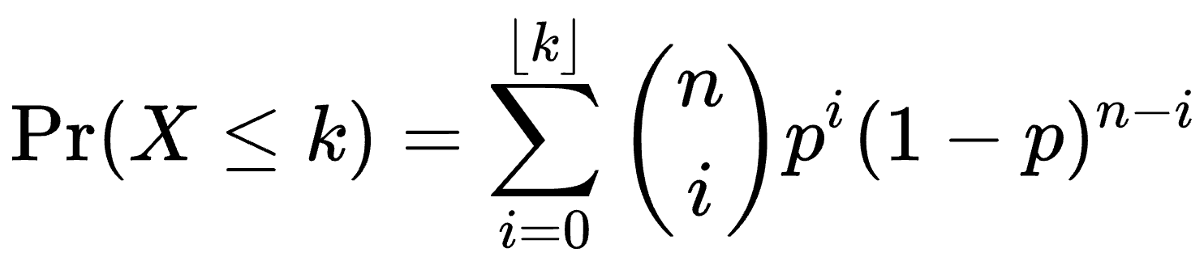
Calculating seropositivity – confidence intervals
Estimating uncertainty is important for capturing true population seroprevalence; it typically accounts for variance around a mean estimate.
Estimating a 95% confidence interval means that in 95 out of 100 calculations of seroprevalence from the same source population using 1000 individuals, the range will include the true population-level seroprevalence.
This method uses a binomial distribution and accounts for the number of people sampled – luckily, we can use R to easily compute it:
With 767 positive individuals and 1000 individuals total, the 95% CI is: 74.0% - 79.3%.

Slide 17
Calculating seropositivity – confidence intervals
With 767 positives and 1000 total samples:
Seroprevalence = 76.7% (95% CI: 74.0%, 79.3%)

Slide 18
Question: How do we interpret seroprevalence?
Interpretation strongly depends on how seroprevalence is determined, including controls used and selected cutoff.
For the seroprevalence of rubella (WRUV):
Percentage of people who have been exposed to vaccine or natural infection.
If we know there’s no/little vaccination, we may assume seroprevalence is due to natural infection, or vice versa.
Since cutoff is a correlate as protection, seroprevalence could also indicate which individuals are susceptible to future infection, and whether there could be outbreaks in a region.

Slide 19
Question: How do we interpret seroprevalence?
How would we interpret seroprevalence if there is NOT a correlate of protection?

Slide 20
Question: How do we interpret seroprevalence?
How would we interpret seroprevalence if there is NOT a correlate of protection?
For antigens in general, seroprevalence could indicate:
Population ever exposed to pathogen or vaccine
Population with recent infection
Population with symptomatic infection
Cross-reactive antibody responses

Slide 21
Controls
If we don’t have a correlate of protection, we can use control samples to determine cutoffs for seropositivity.
Ideally, we could have positive and negative controls.
Often, we only have negative controls, and sometimes we don’t have positive or negative controls.
The controls we use to establish cutoffs can affect our interpretation of seroprevalence.

Slide 22
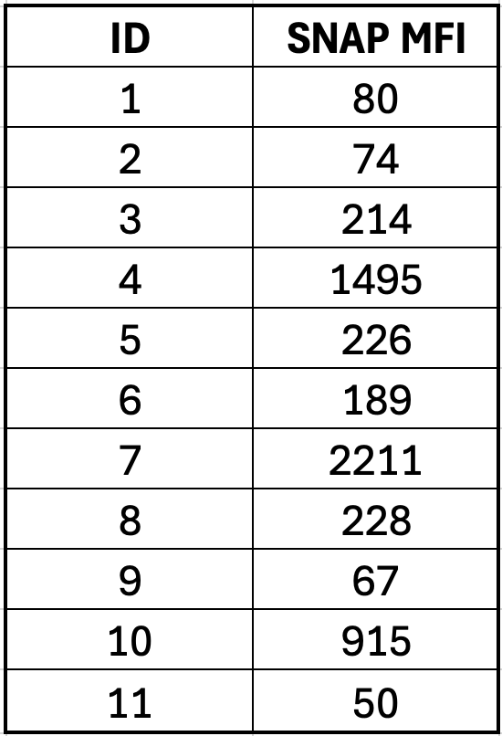
Non-target antigen controls
We also have controls with non-target antigens (SNAP in our dataset, other common ones are GST and Vero cell).
These controls can ensure that the plate ran correctly, whether values are similar between plates, and high values can indicate non-specific binding.
The non-target antigen values should ideally not differ between samples with high and low antigen values.

Slide 23
Positive controls
Often, positive controls are based on antibody responses from people who have symptomatic disease.
How might positive controls differ from positives in samples?

Slide 24
Positive controls
Often, positive controls are based on antibody responses from people who have symptomatic disease.
How might positive controls differ from positives in samples?
Vaccination vs. natural infection
Intensity of infection – severe, symptomatic, asymptomatic – (controls may be more likely to have clinical or severe infection)
Timing since infection (controls likely were taken from acute infection phase)

Slide 25
Negative controls
What populations might be best to get negative controls from?

Slide 26
Negative controls
What populations might be best to get negative controls from?
Non-endemic area (likely to be adults)
Very young presumed unexposed (likely to be from target population)

Slide 27
Negative controls
What populations might be best to get negative controls from?
Non-endemic area (likely to be adults)
Very young presumed unexposed (likely to be from target population)
Why would you choose to get - or not get - controls from each of these populations?

Slide 28
Negative controls
What populations might be best to get negative controls from?
Non-endemic area (likely to be adults)
Very young presumed unexposed (likely to be from target population)
Why would you choose to get - or not get - controls from each of these populations?
Controls from non-endemic area may differ from target population in many ways (geographic, socioeconomic, disease history)
Very young immune systems vs. adult immune systems

Slide 29
Controls
You may not have ideal controls.
You should understand the assumptions/biases of your controls!

Slide 30
Conclusions
You should visualize your data before conducting analysis.
It can be useful to classify samples as seropositive and seronegative, and to calculate seropositivity.
It’s important to understand the controls you use, and how these will affect your inference.

Slide 31
Lecture 4B: Determining serostatus and estimating seroprevalence
May 22, 2025
Seroanalytics Training Blantyre, Malawi

Slide 32
Lecture outline
How to choose a cutoff method
Sensitivity and specificity
Apply different methods for cutoffs
ROC curves
Mean + SD of negative controls
Mixture model

Slide 33
Cutoff methods
There isn’t always a clear answer for how to chose cutoff methods
Today we will go through 4 methods for determining a cutoff:
Externally-defined correlate of protection (covered this morning)
Receiver Operating Characteristic curve (ROC, based on sensitivity and specificity, using both positive and negative controls)
Unexposed population (negative controls)
Finite mixture model (FMM; only based on sample results)

Slide 34

Examples of choosing cutoff methods
Serosurveillance of viral and vaccine-preventable diseases using 47-plex assay
Notes:
https://www.medrxiv.org/content/10.1101/2024.04.26.24306413v1
Investigation of the sero-epidemiology of vaccine preventable diseases and common viral infections in French populations using a multiplex serological assay

Slide 35
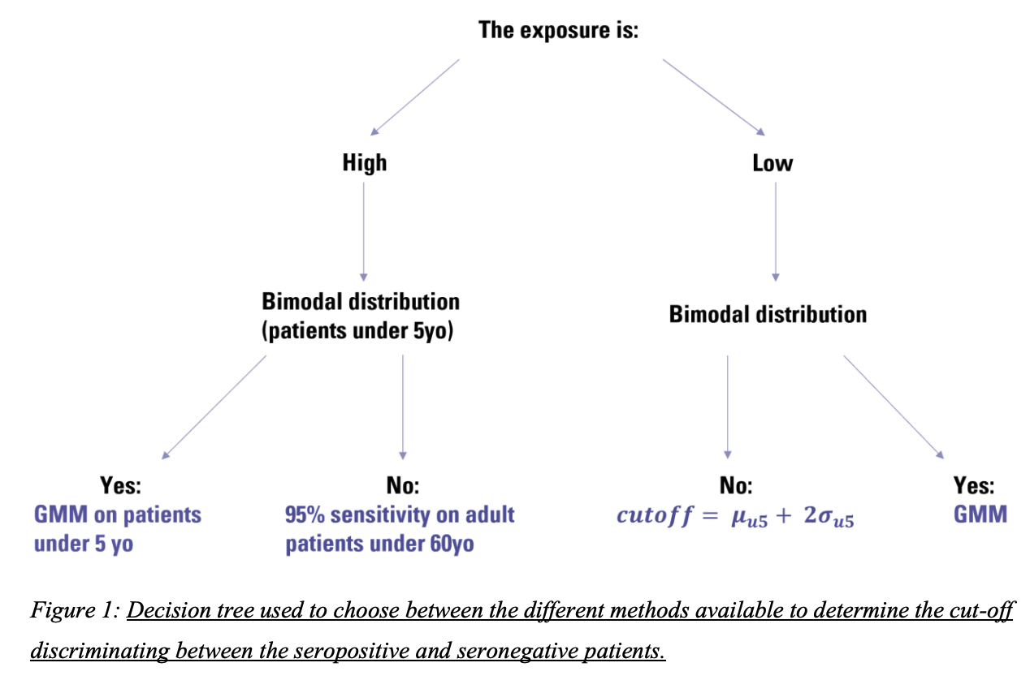
Examples of choosing cutoff methods
Bloch et al. Investigation of the sero-epidemiology of vaccine preventable diseases and common viral infections in French populations using a multiplex serological assay. 2024. medRxiv.
Notes:
https://www.medrxiv.org/content/10.1101/2024.04.26.24306413v1
Investigation of the sero-epidemiology of vaccine preventable diseases and common viral infections in French populations using a multiplex serological assay

Slide 36
Examples of choosing cutoff methods
Are international standards available (like for correlate of protection)?
Yes
No
Use international standard
Are positive and negative controls available?
No
Yes
Are negative controls available?
Use ROC curve; is Youden’s J reasonable?
Yes
No
Use finite mixture model
Yes
Investigate the performance of:
Mean + 3SD of negative controls
Highest negative control
No
Maximize Youden’s J
Maximize specificity with sensitivity ≥ 75%
Example from Zambezia, Mozambique panel; Carcelen et al.
Notes:
https://www.medrxiv.org/content/10.1101/2024.04.26.24306413v1
Investigation of the sero-epidemiology of vaccine preventable diseases and common viral infections in French populations using a multiplex serological assay

Slide 37
Other considerations:
You may want to set up a way to decide cutoffs based on:
Previous methods
Sample and/or control distributions
Information about controls
Whether to prioritize minimizing false negatives vs. false positives
How you want to interpret seropositivity

Slide 38
Classifying controls in serological testing
We can define controls into the following categories:
True positives (TP): Test positive, are positive
False positives (FP): Test positive, are negative
True negatives (TN): Test negative, are negative
False negatives (FN): Test negative, are positive
We need to have positive and negative controls to know which samples are truly positive and truly negative

Slide 39
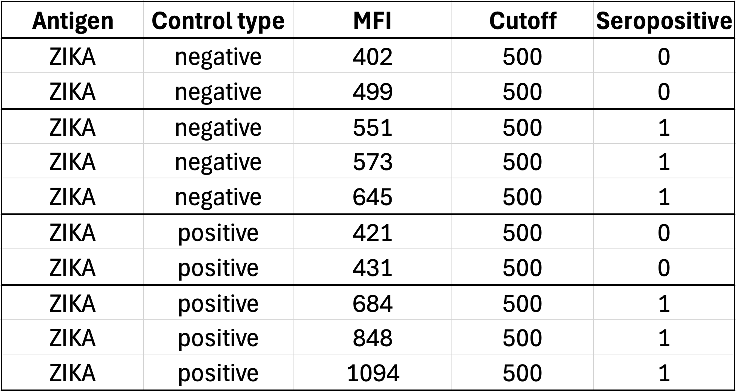
Applying cutoffs to ZIKA antigen controls
Serostatus
Based on cutoff
True negatives
False positives
False negatives
True positives

Slide 40
2X2 table for ZIKA
A 2x2 table is a way to summarize TPs, FPs, TNs, and TPs
 |  | True disease status
 |  | Positive | Negative
Serostatus based on cutoff | Seropositive | 28 | 4
 | Seronegative | 2 | 26
True positives
False positives
True negatives
False negatives

Slide 41
False positives and false negatives: which are “worse”?
When would we want to minimize false positives?
When would we want to minimize false negatives?

Slide 42
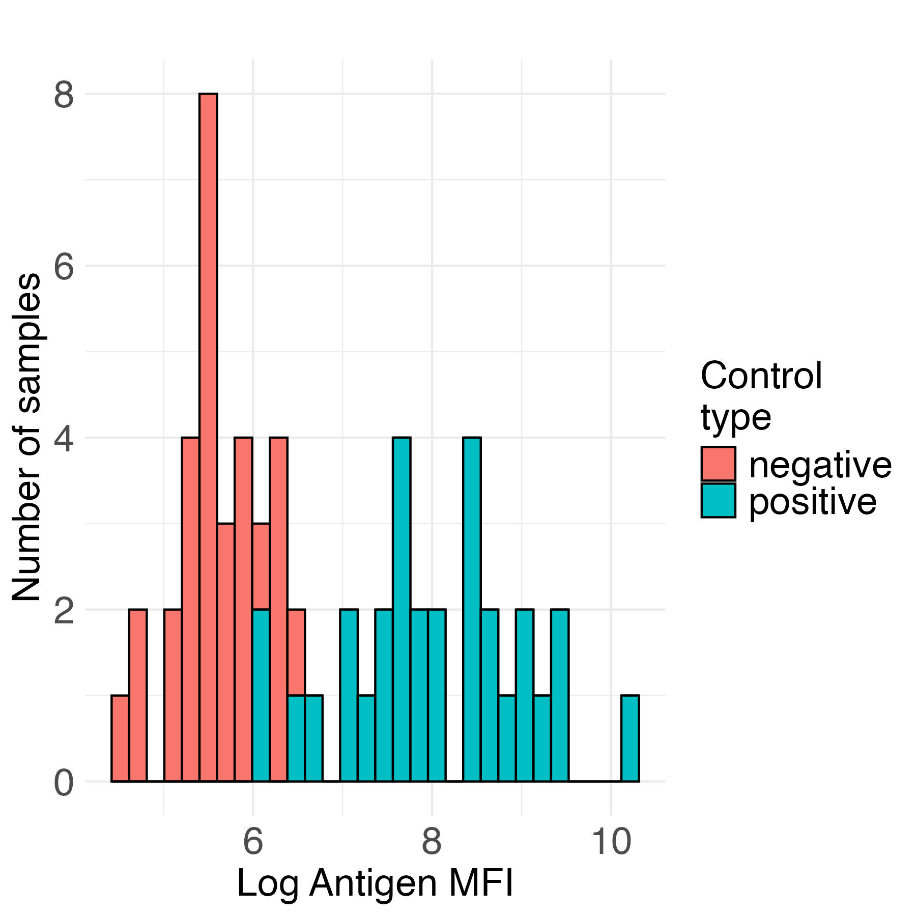
One way to think about this…
minimize false negatives
(maximize sensitivity)
minimize false positives (maximize specificity)
sero- negative
sero-
positive
Antigen MFI

Slide 43
False positives and false negatives: which are “worse”?
When would we want to minimize false positives?
Do not want to over-estimate exposure or immunity
Minimize unnecessary interventions
When would we want to minimize false negatives?
Do not want to miss any cases (risk of further transmission)
E.g., diseases near elimination or in early outbreak
Under-estimate disease burden

Slide 44
False positives and false negatives
In other cases, false positives and false negatives may be equally non desirable.
Then, we can choose to minimize the total number of false positives and false negatives (balanced approach).

Slide 45
Sensitivity and specificity
Sensitivity and specificity are measures of test accuracy that estimate how well true positives and true negatives are being captured.
In serosurveillance, sensitivity and specificity measure how well a cutoff accurately classifies people in the population as seronegative or seropositive.

Slide 46
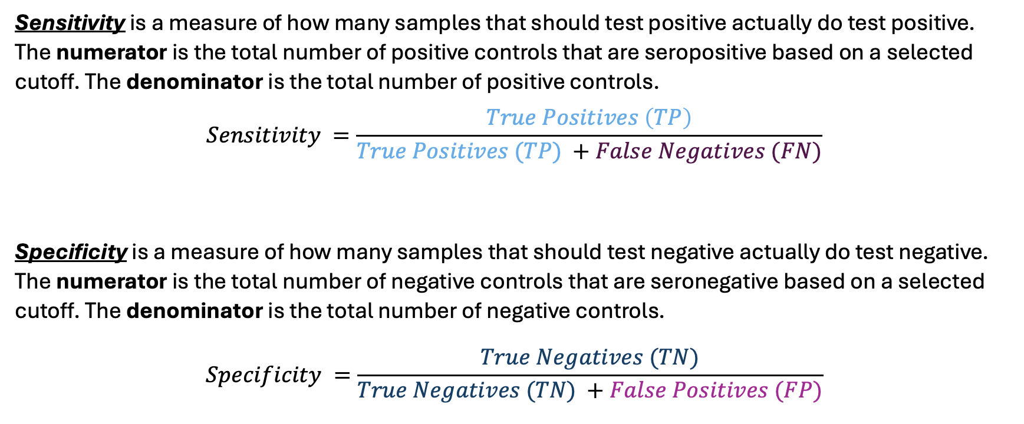
Sensitivity and specificity
Sensitivity is a measure of how many samples that should test positive actually do test positive. The numerator is the total number of positive controls that are seropositive based on a selected cutoff. The denominator is the total number of positive controls.
$$Sensitivity =\frac{True Positives \left(TP\right)}{True Positives (TP) +False Negatives (FN)}$$
Specificity is a measure of how many samples that should test negative actually do test negative. The numerator is the total number of negative controls that are seronegative based on a selected cutoff. The denominator is the total number of negative controls.
$$Specificity =\frac{True Negatives (TN)}{True Negatives (TN) +False Positives (FP)}$$

Slide 47
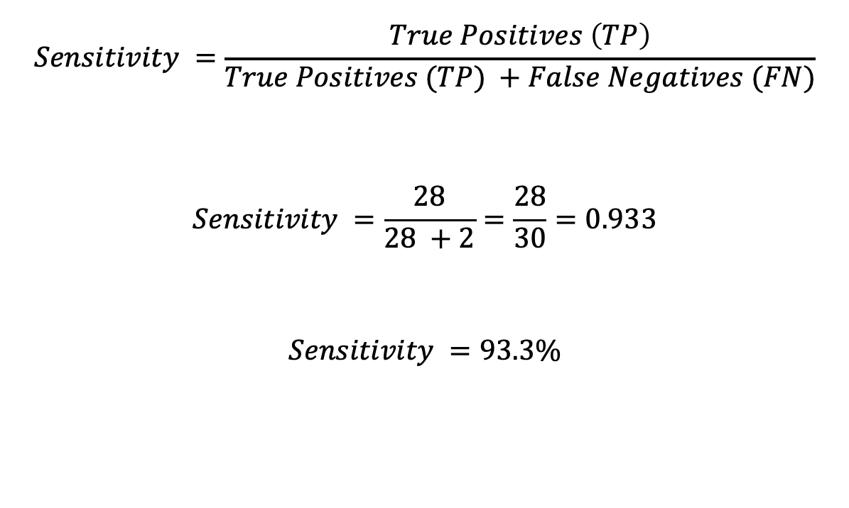
Sensitivity of ZIKA, cutoff = 500
For ZIKA antigen, using a cutoff of 500, we have:
26 true negatives
2 false negatives
28 true positives
4 false positives
$$Sensitivity =\frac{True Positives \left(TP\right)}{True Positives (TP) +False Negatives (FN)}$$
$$Sensitivity =\frac{28}{28 +2}=\frac{28}{30}=0.933$$
$$Sensitivity =93.3\%$$

Slide 48
Sensitivity of ZIKA, cutoff = 500
 |  | True disease status
 |  | Positive | Negative
Serostatus based on cutoff | Seropositive | 28 | 4
 | Seronegative | 2 | 26
True positives
False negatives

Slide 49
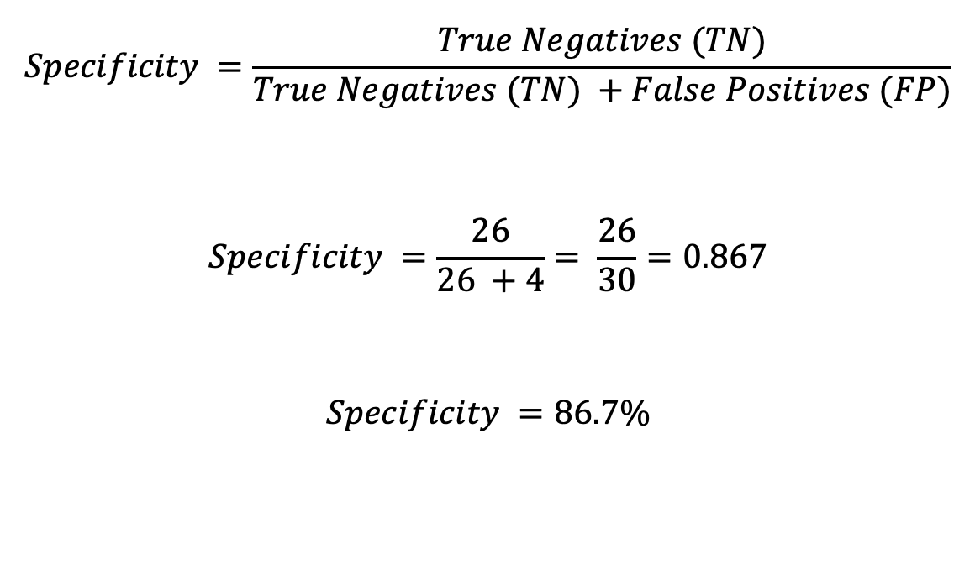
Specificity of ZIKA, cutoff = 500
For ZIKA antigen, using a cutoff of 500, we have:
26 true negatives
2 false negatives
28 true positives
4 false positives
$$Specificity =\frac{True Negatives (TN)}{True Negatives (TN) +False Positives (FP)}$$
$$Specificity =\frac{26}{26 +4}= \frac{26}{30}=0.867$$
$$Specificity =86.7\%$$

Slide 50
Specificity of ZIKA, cutoff = 500
 |  | True disease status
 |  | Positive | Negative
Serostatus based on cutoff | Seropositive | 28 | 4
 | Seronegative | 2 | 26
False positives
True negatives

Slide 51
Receiver Operating Characteristic (ROC) Curve
If we have positive and negative controls, we can compare sensitivity and specificity to help determine a cutoff.
The ROC curve uses known positive and negative controls to compare sensitivity vs. specificity.
We can use the ROC curve to choose a cutoff value that minimizes false positives and false negatives.

Slide 52
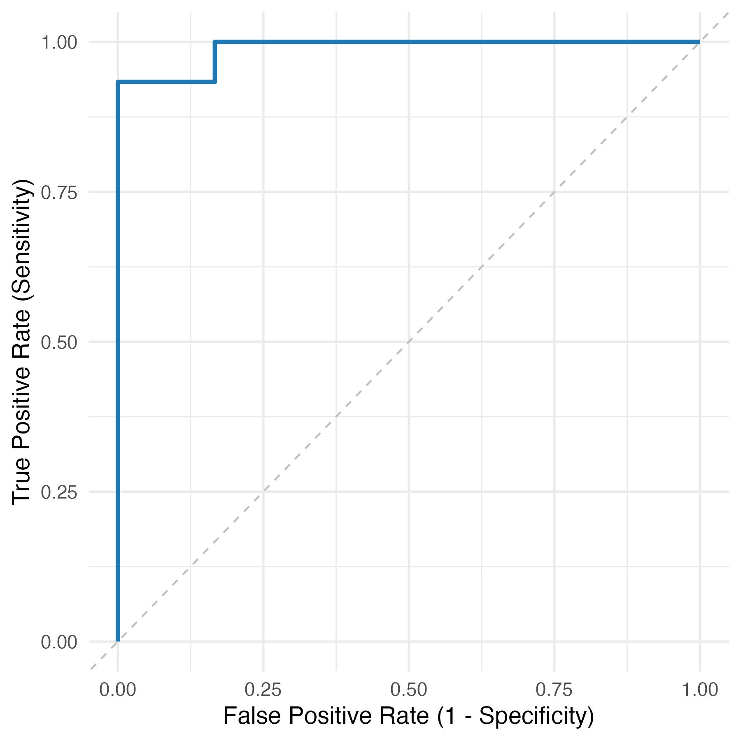
ROC Curves
The ROC curve shows sensitivity (true positive rate) and 1 – specificity (false positive rate) calculated at many different cutoff values.

Slide 53
ROC Curves
If the curve is close to the top left corner, then we can identify a cutoff with high sensitivity and specificity
Y-axis is sensitivity, equal to true positive rate
X-axis is 1-Specificity, equal to false positive rate

Slide 54
Choosing a cutoff from ROC Curve
The ROC curve shows us how sensitivity and specificity change as we adjust the cutoff value. It does not give a specific cutoff value.
How to chose what cutoff to chose:
Consider: Is it worse to have false negatives or false positives?
Is it worse to have false positives (labeling negative people as positive)? For example, for a rare disease?
Is it worse to have false negatives (missing seropositive people)?
Or are false positives and false negatives equally bad?

Slide 55
Cutoffs from ROC curve – Youden’s Index
One common method to choose a cutoff from a ROC curve is to use Youden’s Index
This method assumes false positive and false negatives are equally bad
This method finds the cutoff that maximizes Sensitivity + Specificity – 1

Slide 56
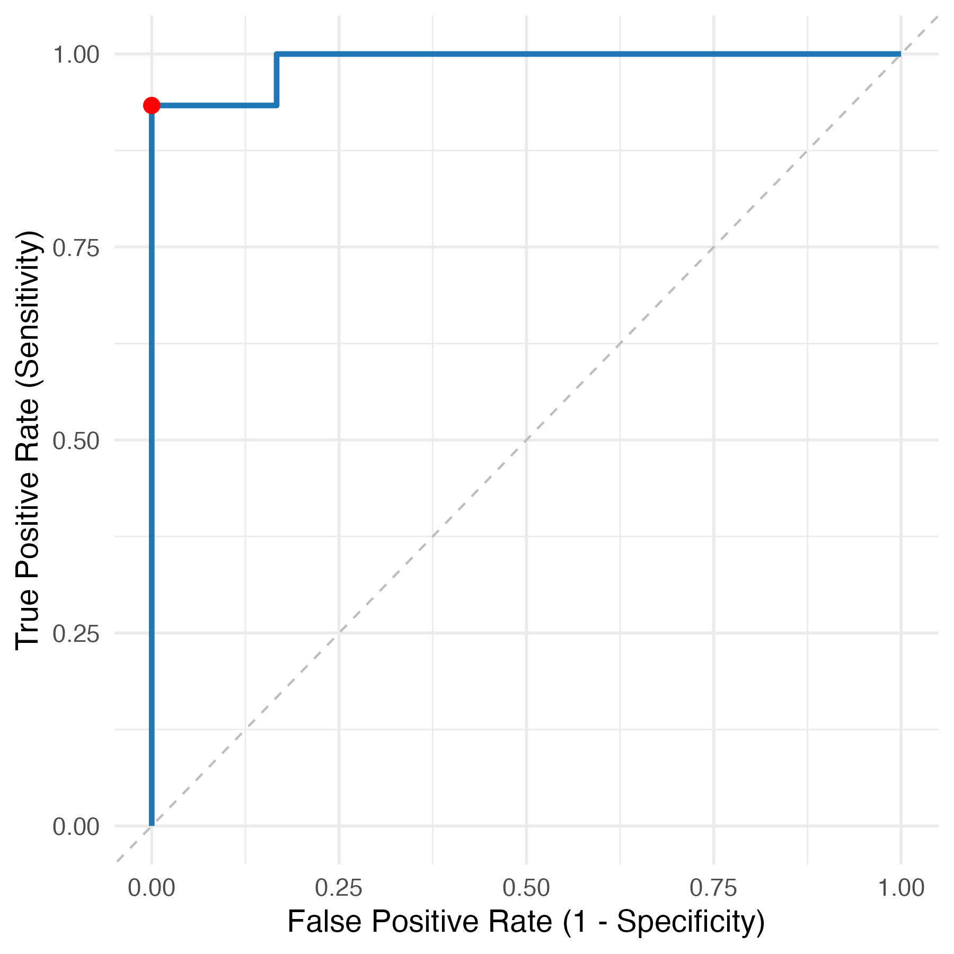
Cutoffs from ROC curve – Youden’s Index
When we maximize Sensitivity + Specificity – 1 for this ROC curve:
Cutoff based on Youden’s index: TPR: 0.933 FPR: 0
Cutoff: 664.5
Notes:
Youden’s Index = TPR – FPR = 0.933 – 0 = 0.933 (max is 1)

Slide 57
Cutoffs from ROC curve
Can also adjust the cutoff if we primarily want to minimize false positives or false negatives, for example:
If we are concerned about too many false positives, we could set a minimum value for specificity (e.g., find cutoff that provides maximum sensitivity while maintaining >80% specificity)

Slide 58
ROC curve summary
Advantages:
Flexibility to prioritize sensitivity or specificity
Disadvantages:
Requires positive and negative controls
Controls may differ from sample population

Slide 59
Mean + Standard Deviation
This method uses negative controls: for example, from a non-endemic region or from young individuals who are presumed to be unexposed
Cutoff = mean + 2 or 3 standard deviations
If negative controls are normally distributed:
Only ~2.5% of negatives are expected to be above mean + 2SDs
Only ~0.14% of negatives are expected to be above mean + 3SDs

Slide 60
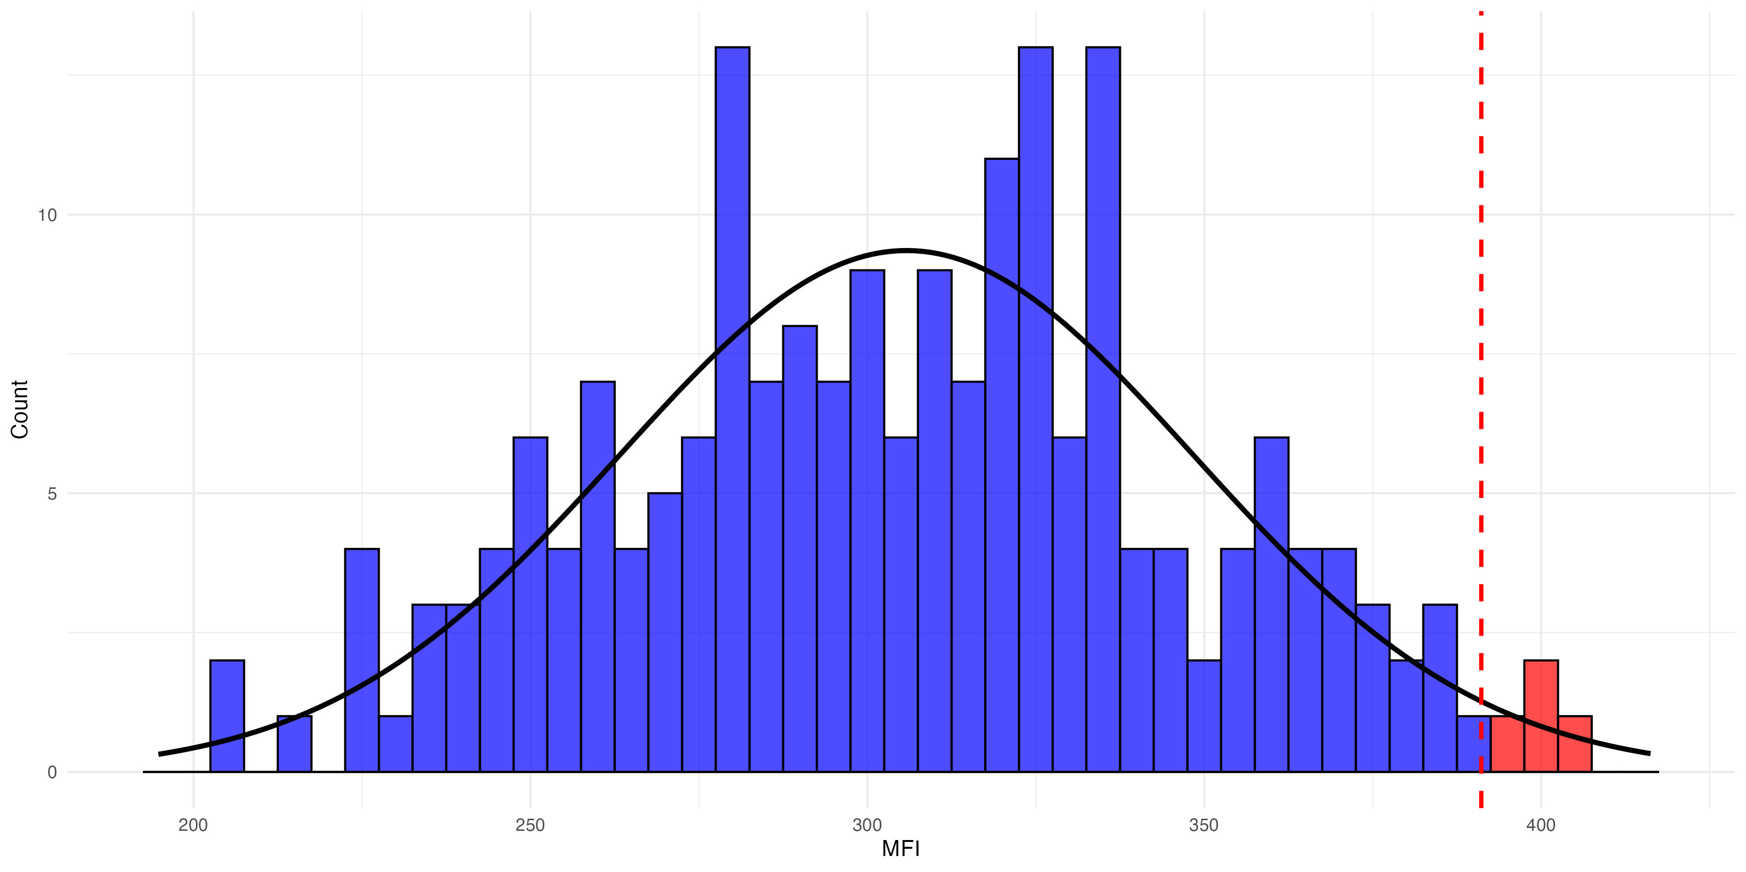
Unexposed controls
If controls are normally distributed: For mean + 2 SDs, we expect 2.5% of negative samples to be greater than cutoff (i.e., assay has 97.5% specificity).
Notes:
The data shows a simulated normal distribution. The curve models a normal distribution. Samples above the cutoff are shown in red and samples below the cutoff are shown in blue.

Slide 61
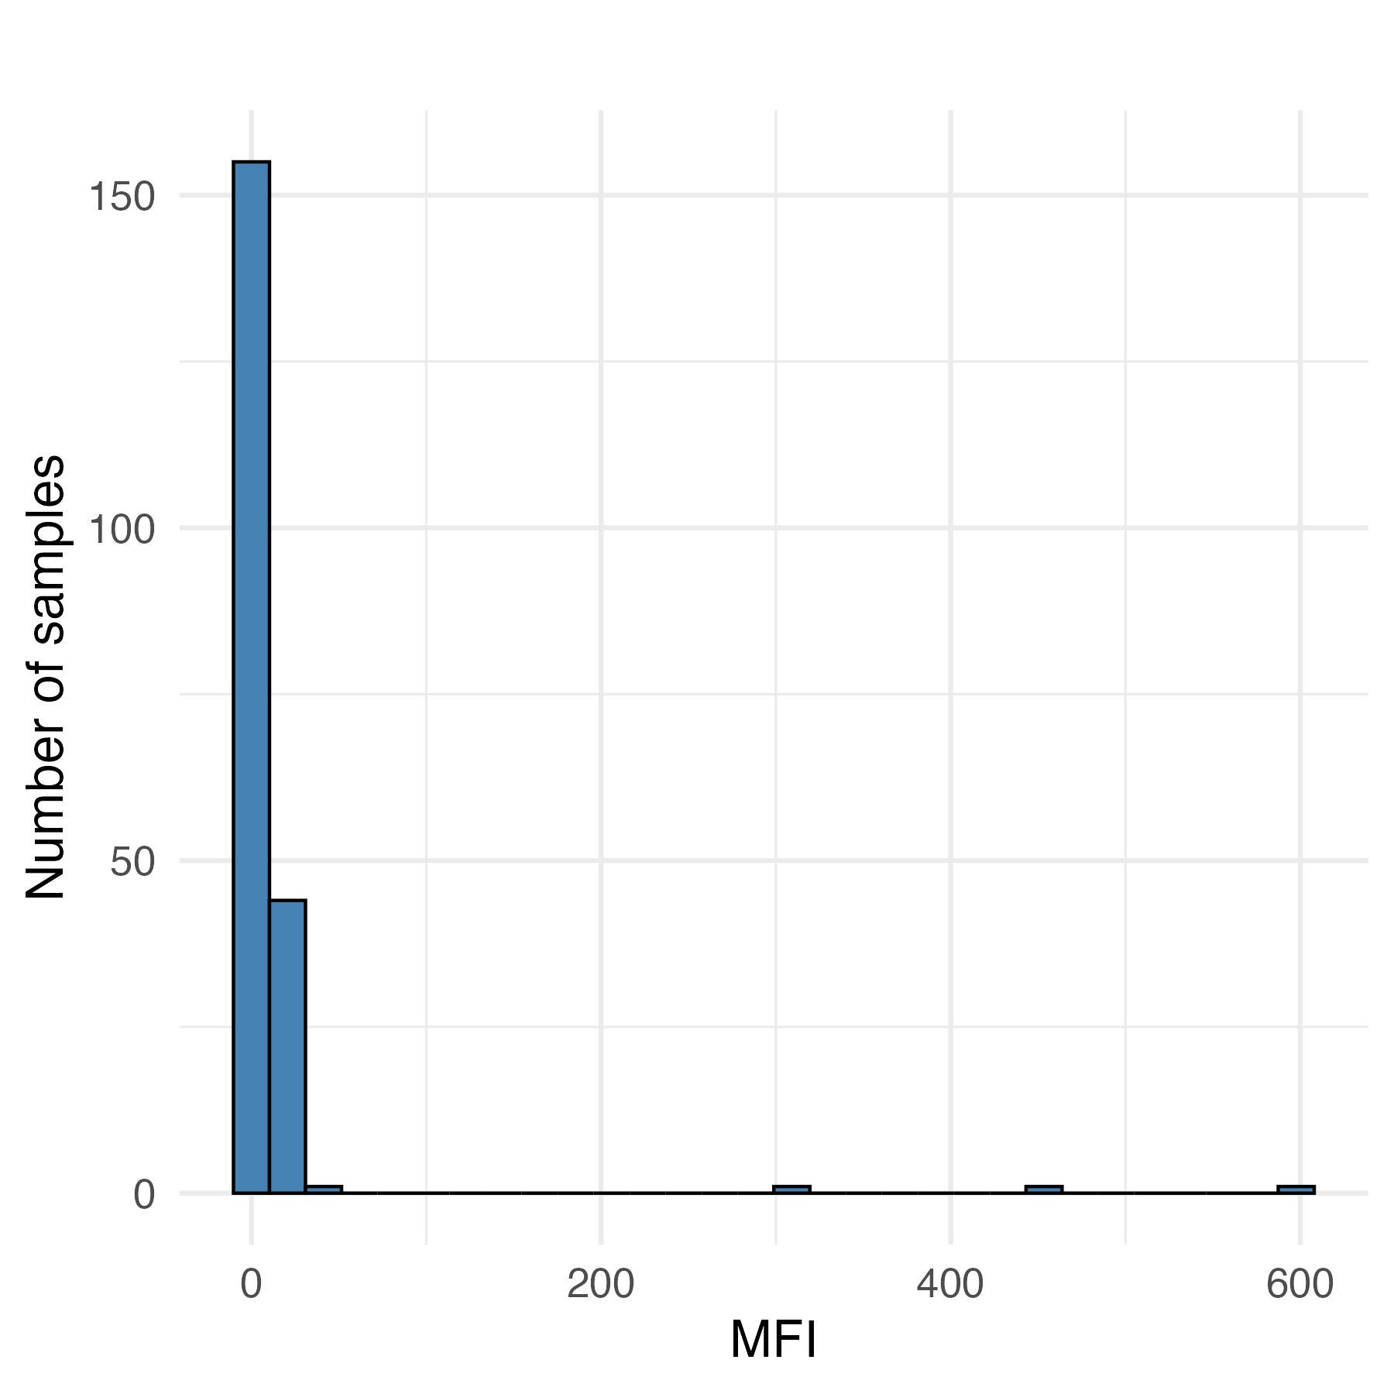
Unexposed controls
There can sometimes be outliers in unexposed controls (high-responders)
This could be a reason for a non-normal distribution
A more conservative approach is using highest negative control (equals 100% specificity)
It’s also worth investigating the outlier samples to try to understand if they were truly unexposed
Outliers
Notes:
Advantage: only requires negative controls, which may be easier to obtain than positive controls, especially for rare diseases

Slide 62
Unexposed controls
Advantages:
Simple to implement
Doesn’t require positive controls (often harder to find, depending on pathogen)
Disadvantages:
Negative controls should be comparable to true negative samples in population
Specificity may be challenging to estimate depending on the number and distribution of negative controls
Can’t estimate sensitivity or numbers of false negatives (if no positive controls)

Slide 63
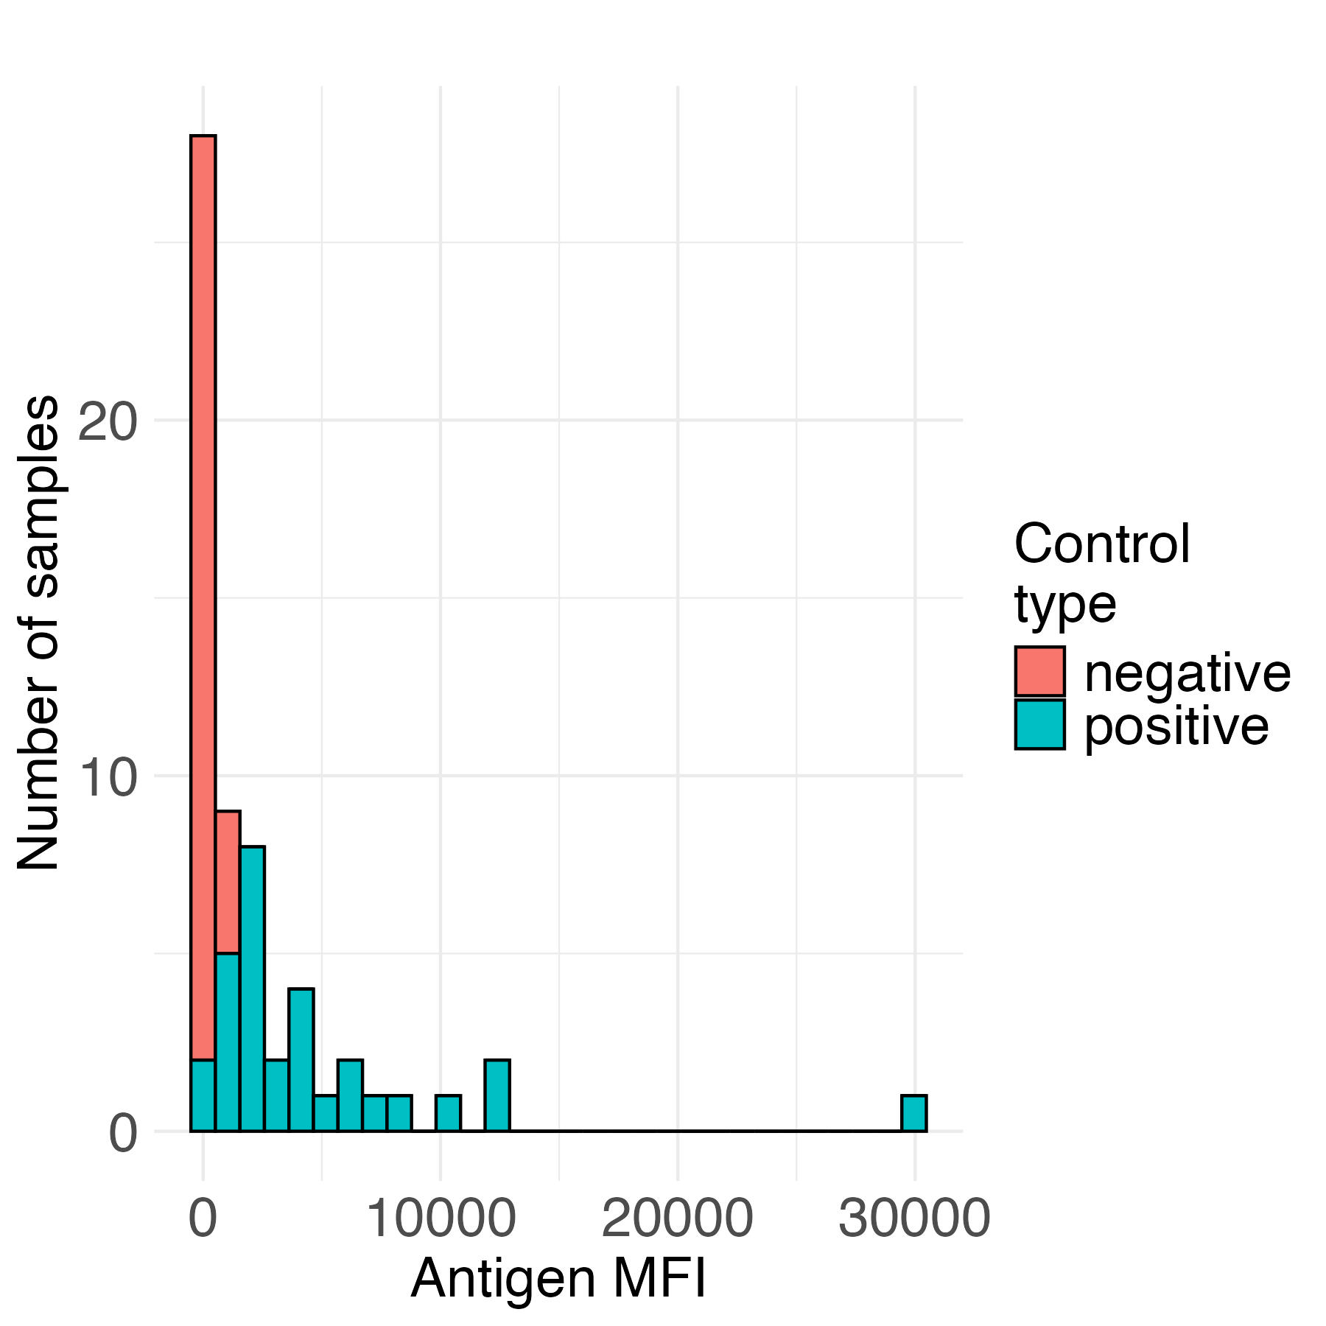
Distributions of controls
For ZIKA antigen: Overlap between distributions of true positives and negatives
Untransformed
Log scale

Slide 64
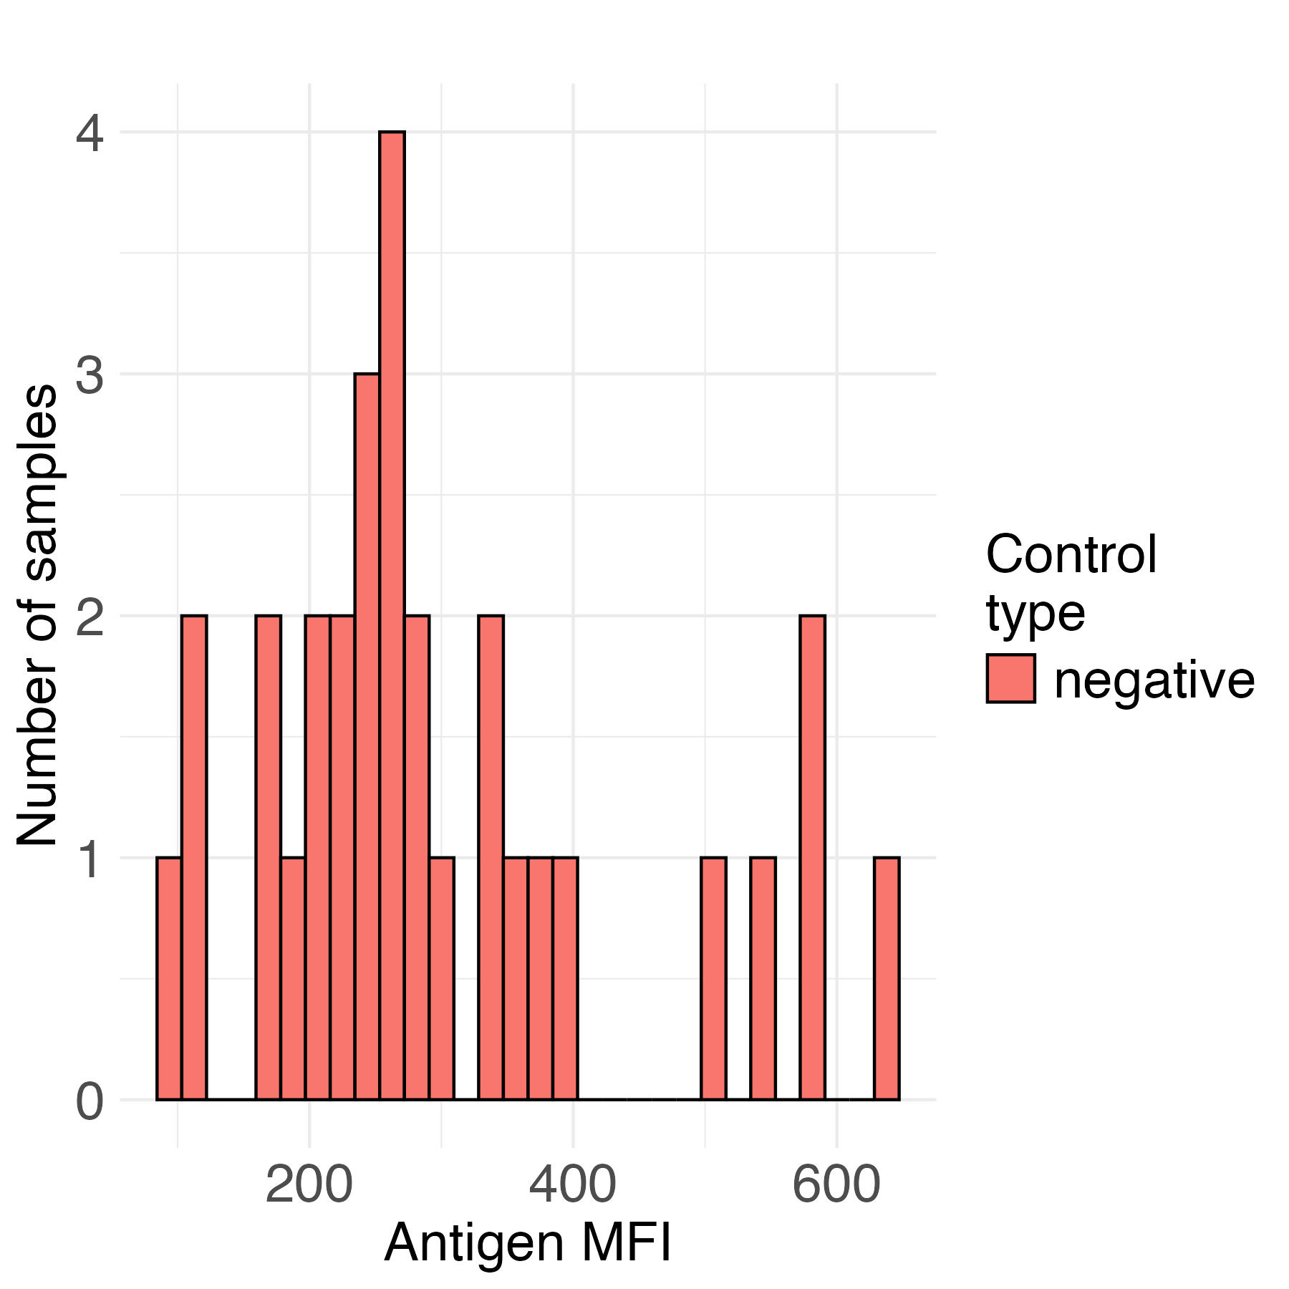
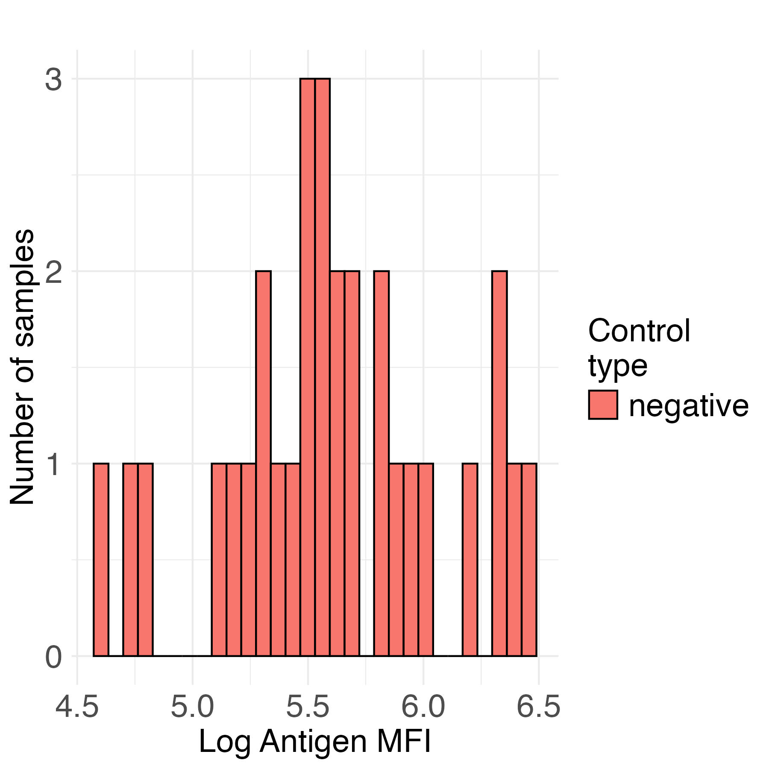
Distribution of negative controls
ZIKA antigen negative controls
Untransformed
Log scale

Slide 65
Cutoffs using ZIKA negative controls:
Mean log(ZIKA negative controls) = 5.600
SD log(ZIKA negative controls) = 0.473
Cutoff = mean + 2 SD of negative controls
Cutoff = exp(5.600 + 2 * 0.473) = exp(6.545) = 695.9
Cutoff = mean + 3 SD of negative controls
Cutoff = exp(5.600 + 3 * 0.473) = exp(7.018) = 1116.5

Slide 66
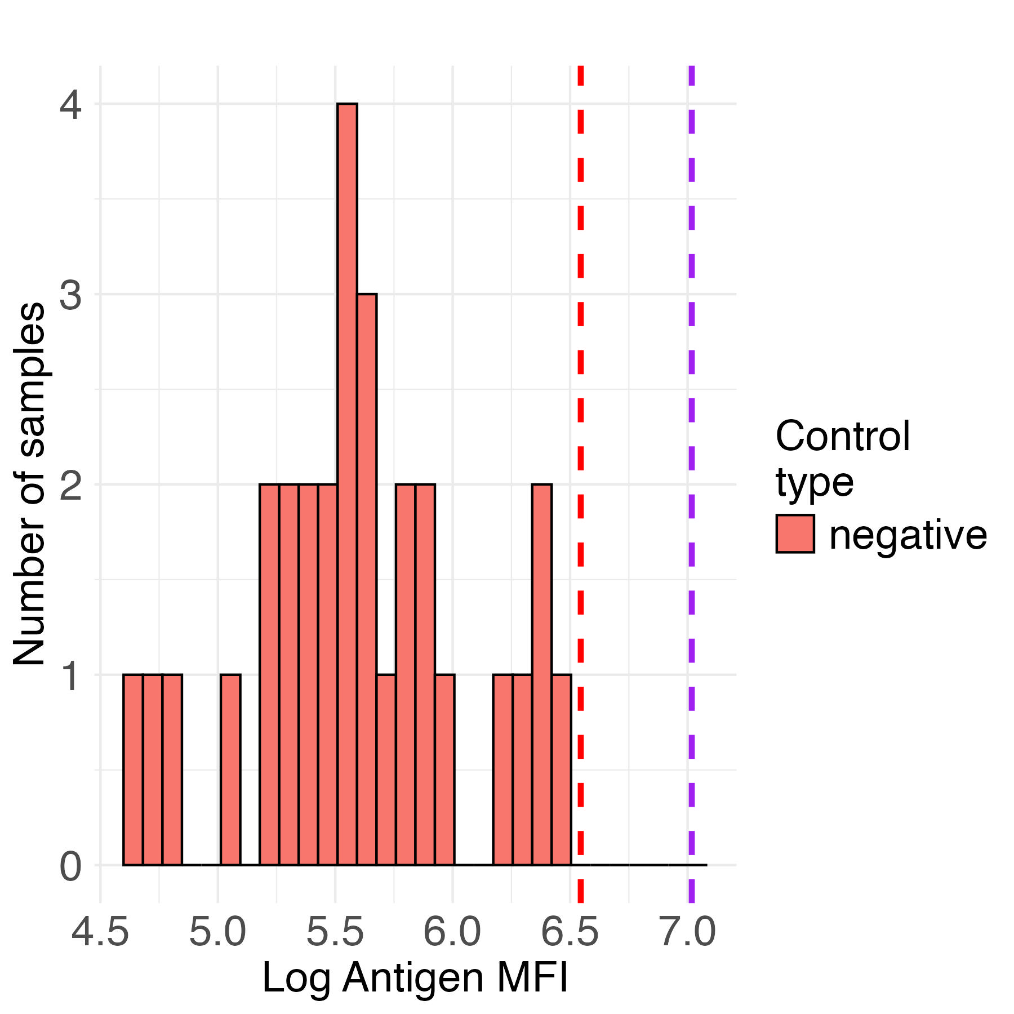
Cutoffs using ZIKA negative controls:
Histogram of negative controls with cutoffs:
In red: Mean + 2SD = 695.9
In purple: Mean + 3SD = 1116.5

Slide 67
Specificity of ZIKA antigen
For a cutoff = 695.9:
If no positive controls available:
 |  | True disease status
 |  | Positive | Negative
Serostatus based on cutoff | Seropositive | - | 0
 | Seronegative | - | 30

Slide 68
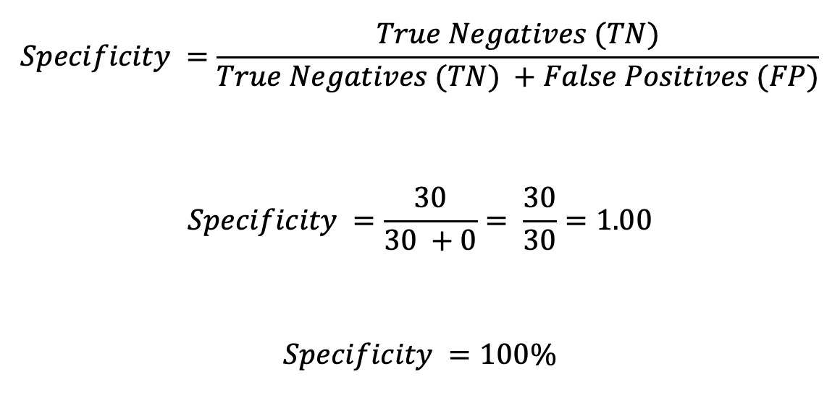
Specificity of ZIKA antigen
For a cutoff = 695.9:
$$Specificity =\frac{True Negatives (TN)}{True Negatives (TN) +False Positives (FP)}$$
$$Specificity =\frac{30}{30 +0}= \frac{30}{30}=1.00$$
$$Specificity =100\%$$

Slide 69
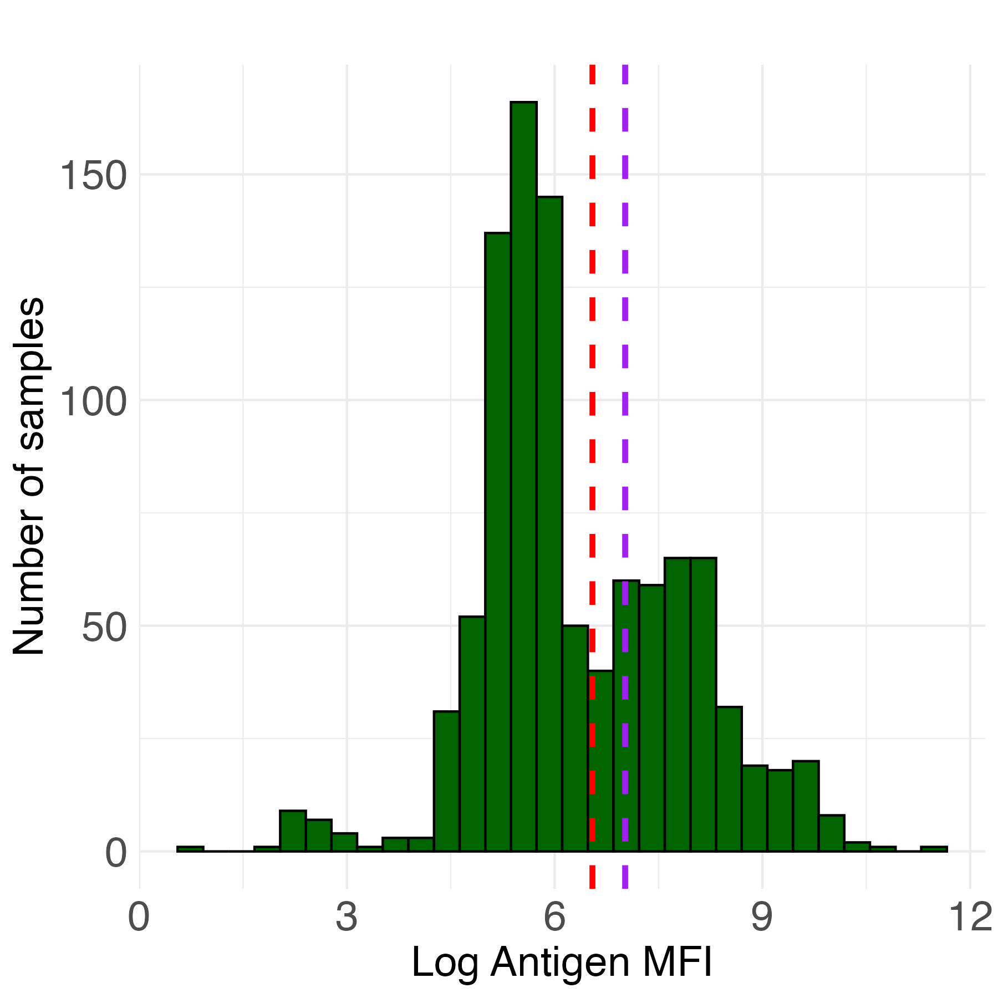
Cutoffs using ZIKA negative controls:
Histogram of samples
with cutoffs:
In red: Mean + 2SD = 695.9
In purple: Mean + 3SD = 1116.5

Slide 70
Mixture models
Mixture models are the only method to estimate (1) the probability that a sample is seropositive and (2) seroprevalence directly from the sample distribution
Does not require positive or negative controls

Slide 71
Mixture models
Advantage:
Doesn’t require positive or negative controls
Disadvantage:
Only works if we can identify distributions representing exposed and unexposed individuals (ideally with minimal overlap)

Slide 72
Mixture models
Why may we not see two distinct distributions for exposed and unexposed individuals in a population (e.g., either 1 or 3+ distributions)?
Almost all / almost no individuals exposed
Waning antibodies over time
Cross-reactive antibodies
Magnitude of antibody response could vary with intensity of infection
Natural infection vs. vaccination

Slide 73
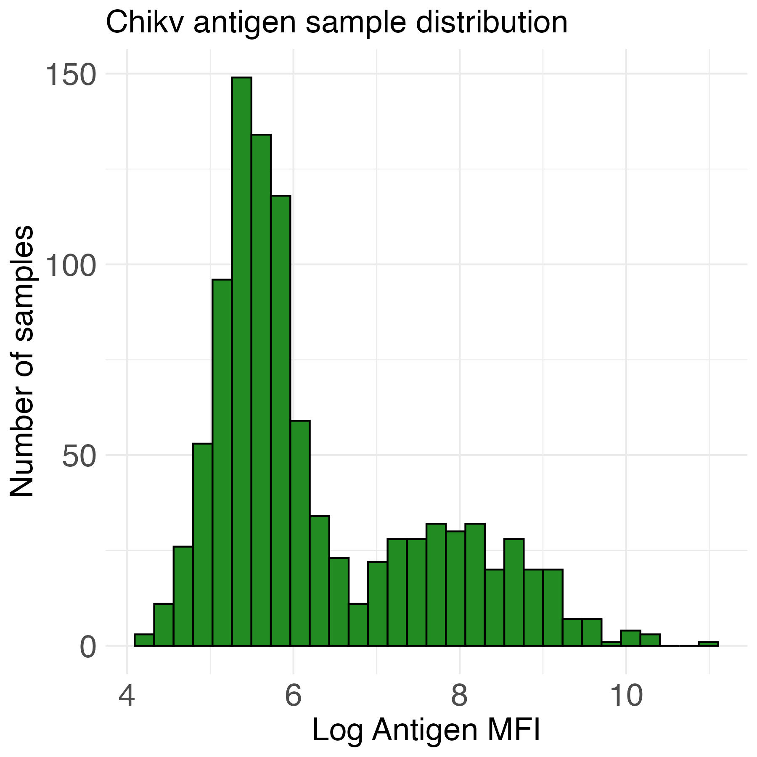
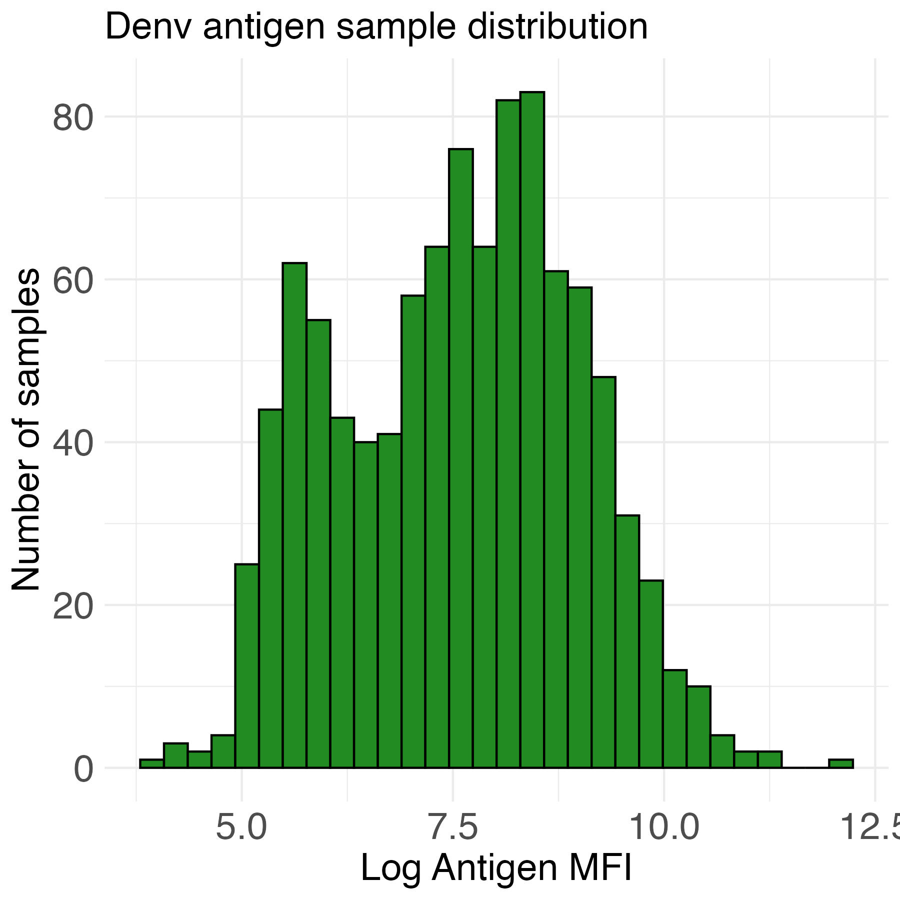
Mixture models
Chikv and Denv could be appropriate distributions for fitting a mixture model (possibly two components per antigen)

Slide 74
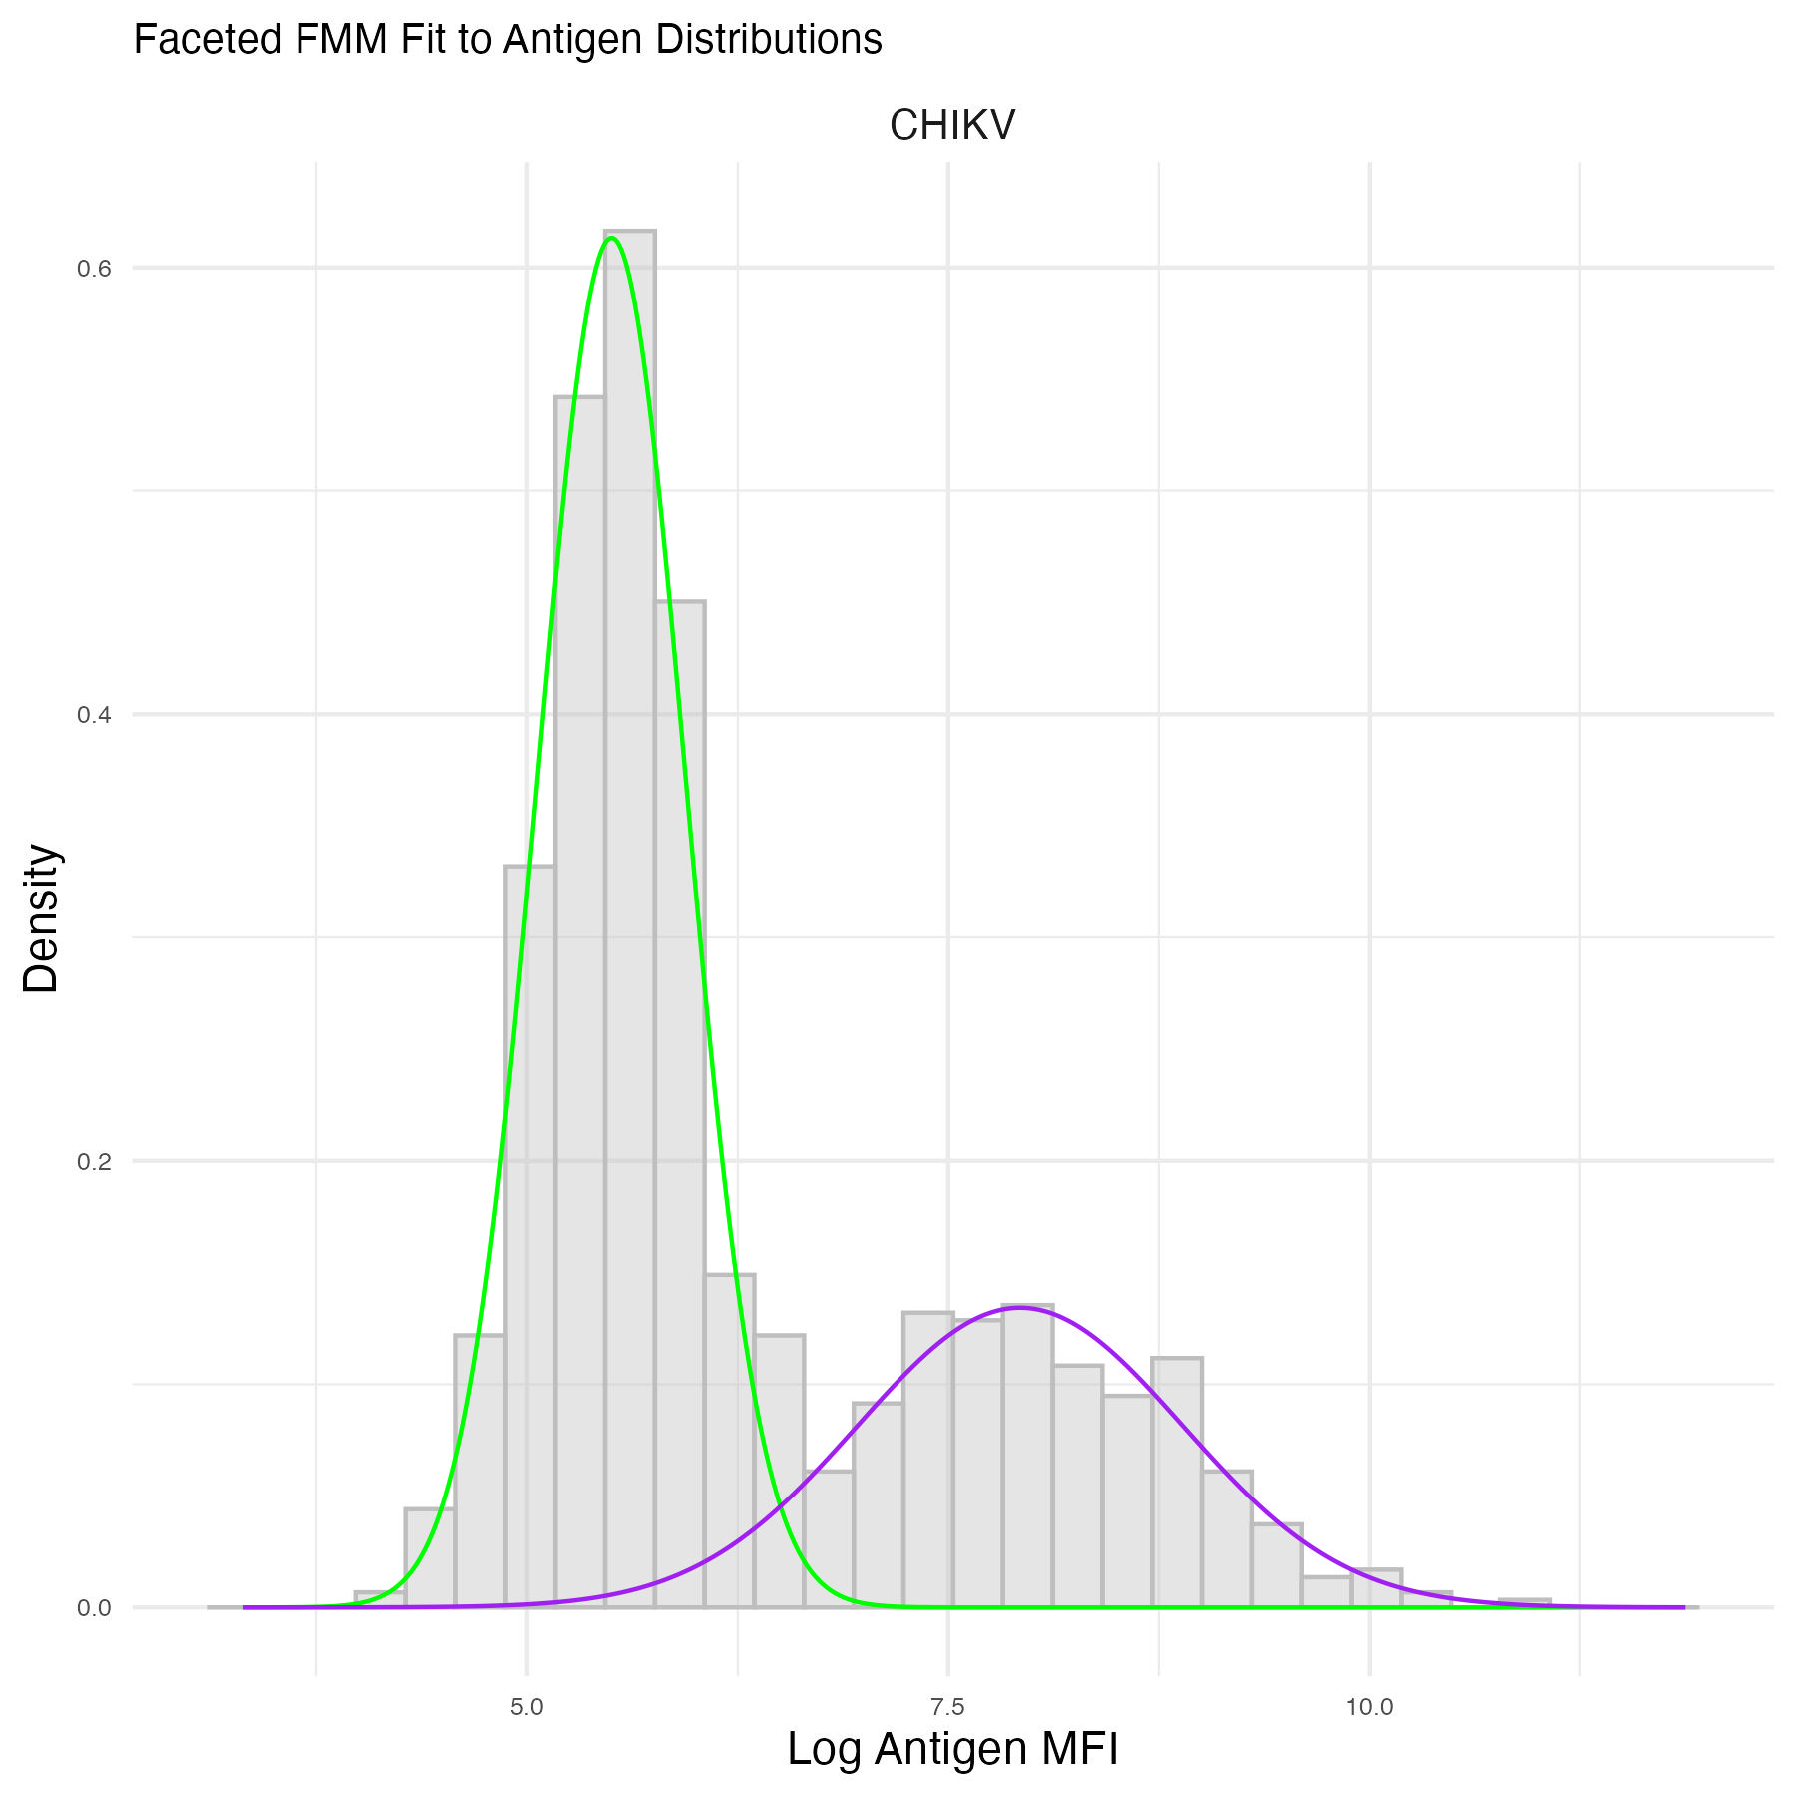
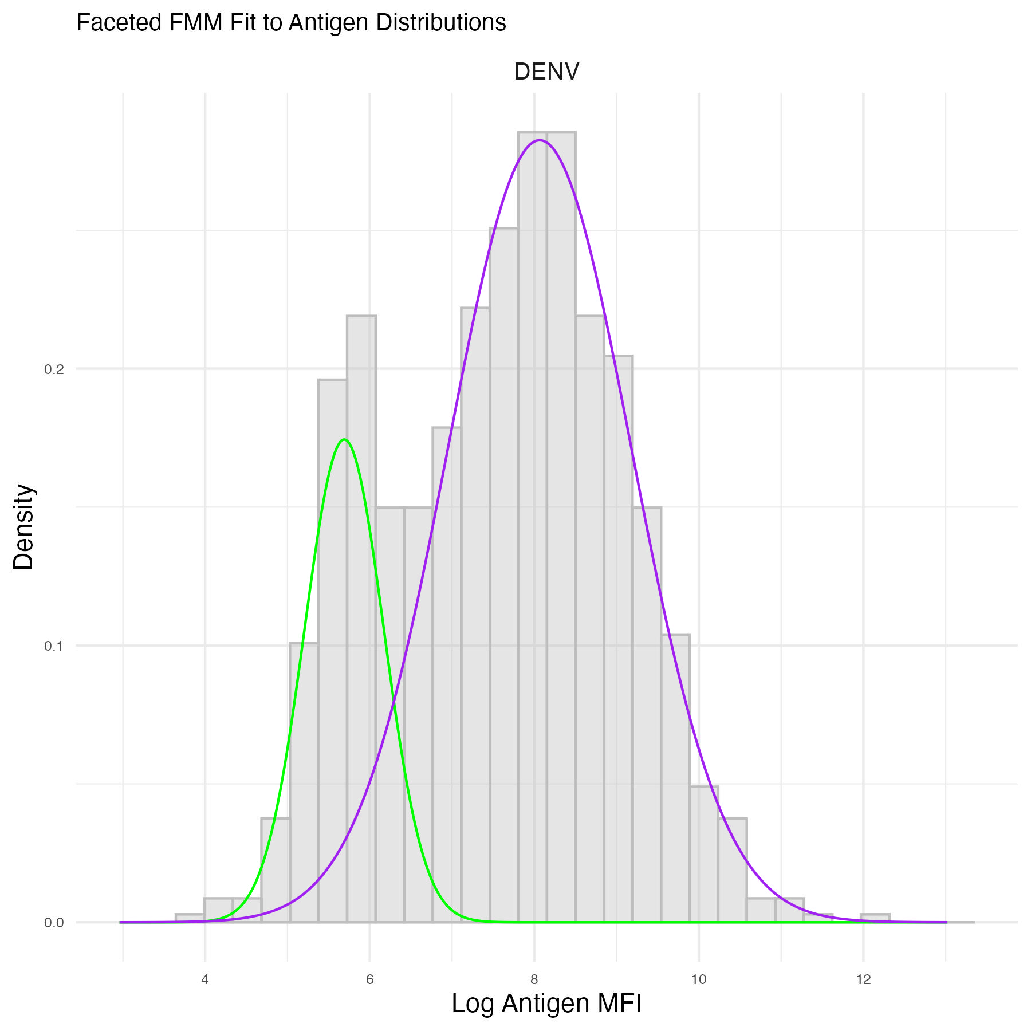
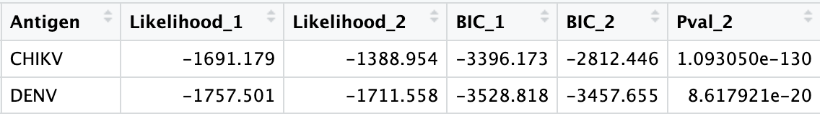
Mixture models
Statistics also show that 2 components fit these distributions better than 1 component
Notes:
The statistics show that bimodal distributions fit

Slide 75
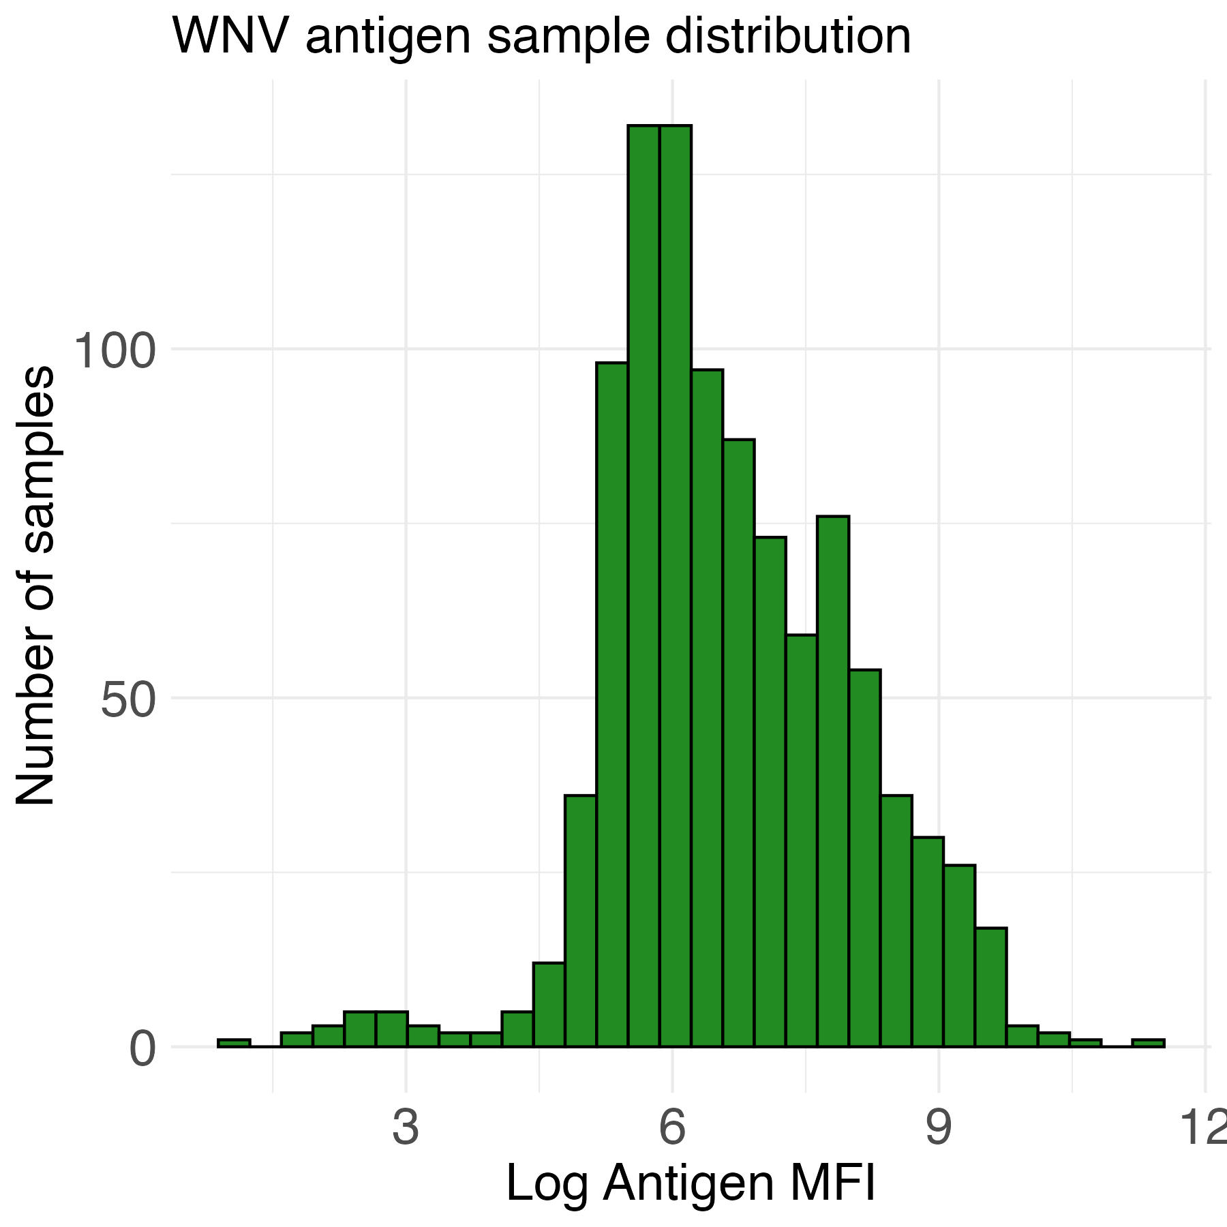
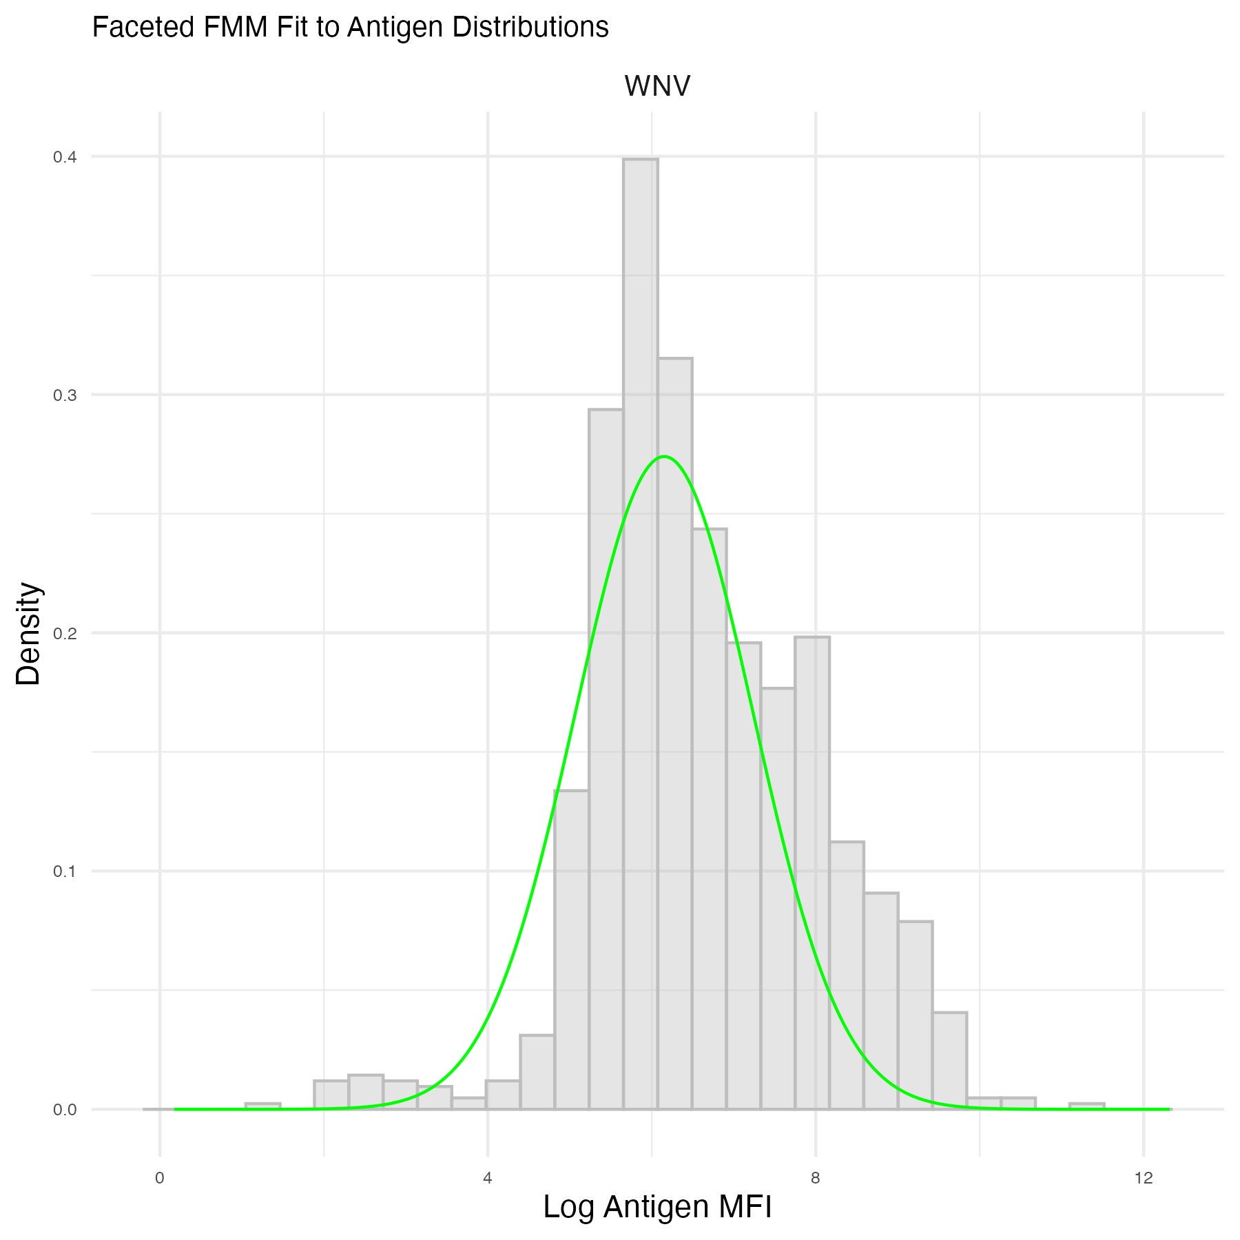
Mixture models
Some antigen distributions like West Nile Virus are not as good:
One component is best fit

Slide 76
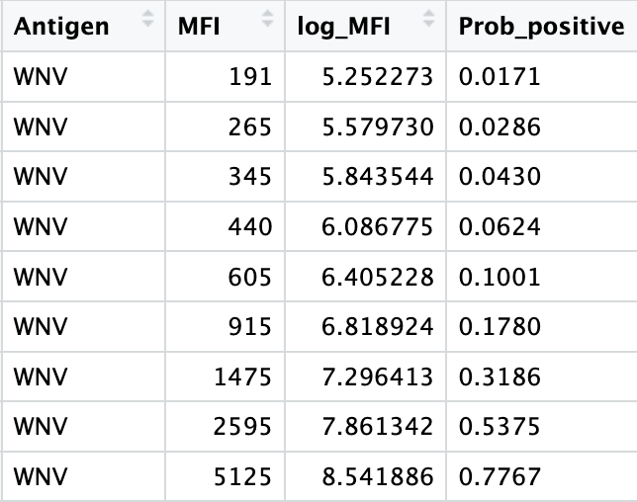
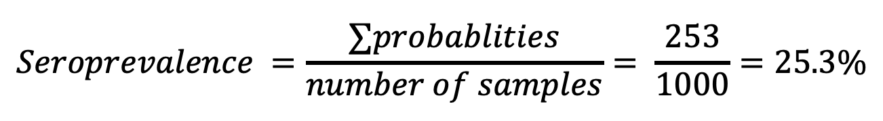
Mixture models
Unlike other methods, this method doesn’t calculate a cutoff
Instead, it calculates the probability of each sample being seropositive
Seroprevalence equals the sum of the individual-level probabilities of being seropositive
$$Seroprevalence =\frac{∑probablities}{number of samples}= \frac{253}{1000}=25.3\%$$
Notes:
Please note that while some people will use a probability of 50% to determine seropositivity (i.e., assign a binary positivity status) at the individual-level, this is not advised and can result in biased results. Here, we recommend using the mixture model to directly estimate the population-level seroprevalence by summing the individual-level probabilities.

Slide 77
Conclusion
Methods to determine seropositivity come with different assumptions, which are important to understand.
The method you choose will depend on your study and the particular antigen(s), in addition to controls available, and sample and control distributions.

